Slide 1


Slide 2
Pledge and National Anthem
All those present or watching online please stand for the Pledge of Allegiance (and National Anthem)
(pause until audience is standing)
Ready, Begin "I pledge allegiance to the Flag of the United States of America, and to the Republic for which it stands, one Nation under God, indivisible, with liberty and justice for all."
(begin National Anthem if included)
Thank you. You may be seated.

Slide 3
1
Welcome students, families, and community members from across the great state of Utah. I’m Mayor Green speaking to you from Cedar City City Hall. During the 2023 Legislative session, the Utah Legislature passed House Bill 179 marking the month of September as Constitution and Founders Recognition Month. This bill encourages all members of our community to study and celebrate the Supreme Law of our Land - the United States Constitution, the individuals who wrote it, and the founding principles of liberty it has preserved for each one of us.
(1)
Continue on next slide

Slide 4
1
In the summer of 1787, at the Constitutional Convention, held at Independence Hall in Philadelphia, Pennsylvania. Thirty-nine members attending the Convention signed the Constitution before returning to their home states to present it to their constituents for ratification.
Continue on next slide
(2)

Slide 5
1
Our Constitution is over 230 years old. Creating it required great debate, heated disagreements, and difficult compromise. It continues today to stand as a beacon to us and all nations that even through our challenges, liberty is possible with civil debate and thoughtful compromise.
Continue on next slide
(3)

Slide 6
1
Since the Constitution's ratification, 27 amendments have been added. Plans for changes to the Constitution were rooted in the design from the start. Today's readers will acknowledge where the language has been changed. Notice how many times “we the people” have come together as a nation and made improvements to the Supreme law of our land.
Continue on next slide
(4)

Slide 7
1
Join us for the next 45 minutes as we accept our individual responsibility to be educated on the rules by which we are governed. Please open your pocket Constitution books to the first page where the Preamble begins.
(5)

Slide 8
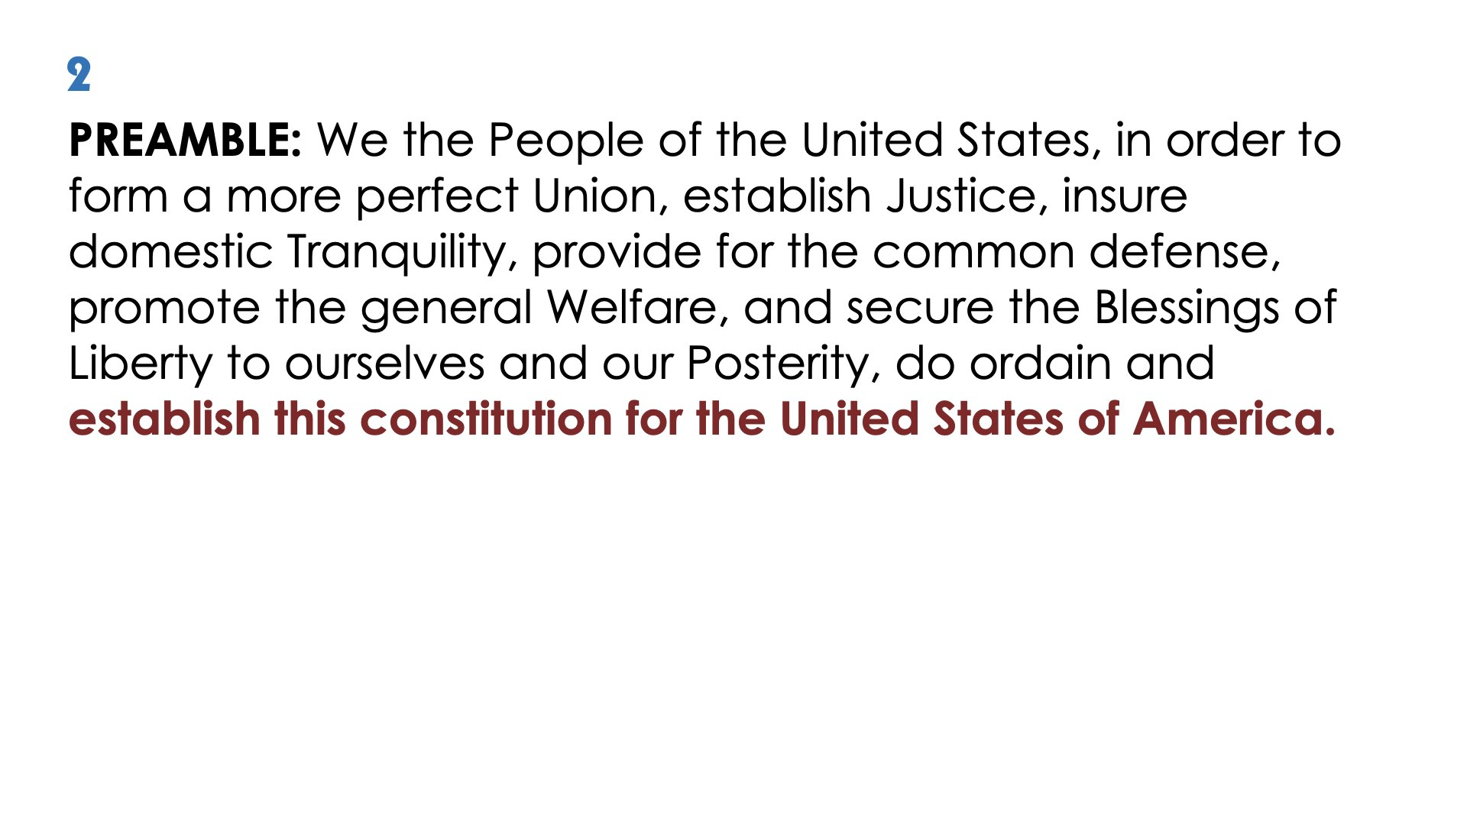
Please join me in reciting the Preamble to the Constitution.
Ready, Begin.
We the people of the United States in order to form a more perfect Union, establish Justice, insure domestic Tranquility, provide for the common defense, promote the general Welfare, and secure the Blessings of Liberty to ourselves and out Posterity, do ordain and establish this constitution for the United States of America.

Slide 9
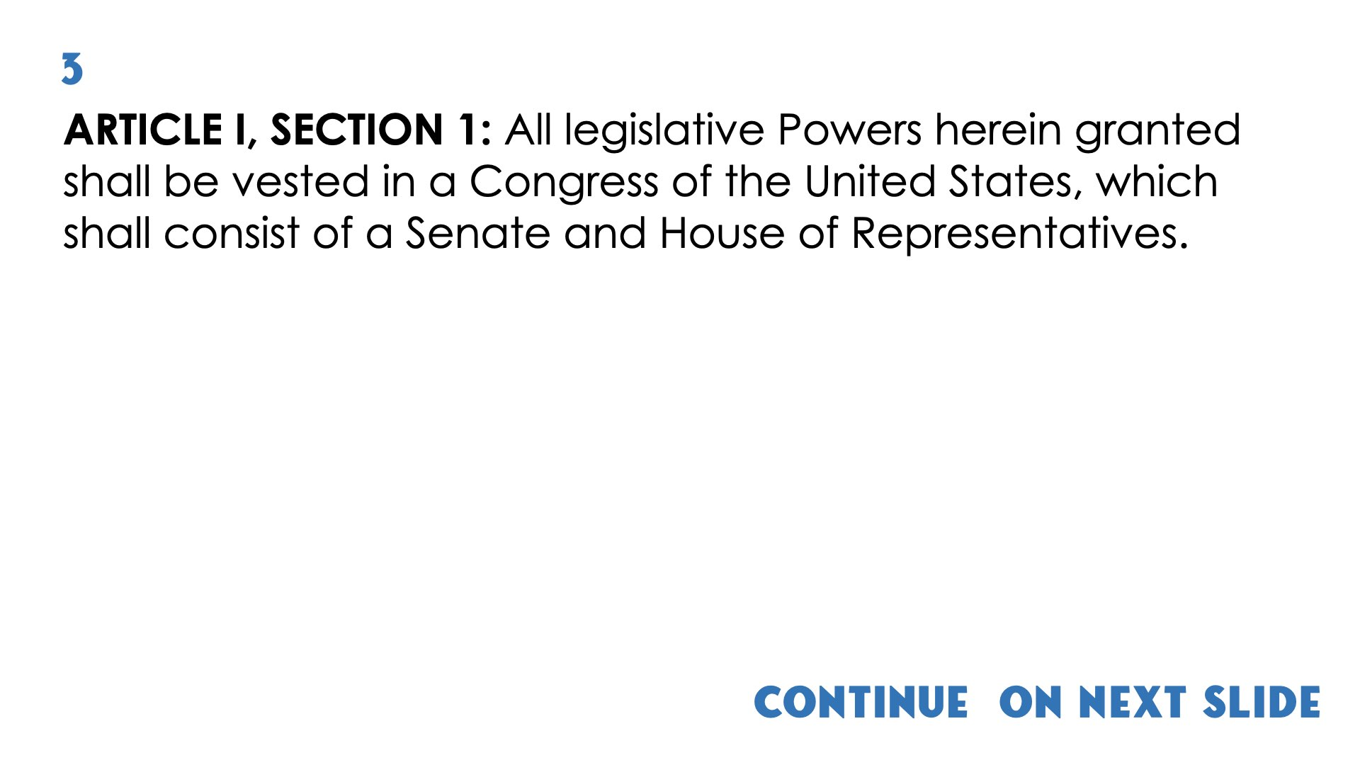
Continue on next slide

Slide 10
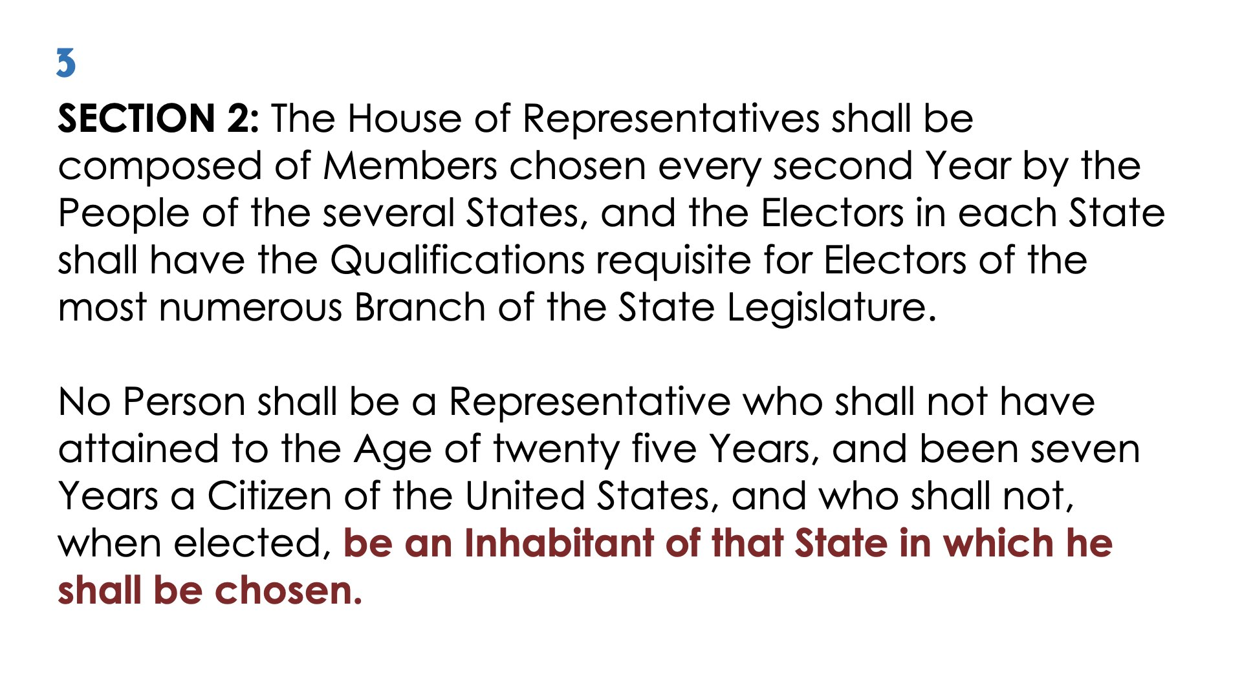

Slide 11
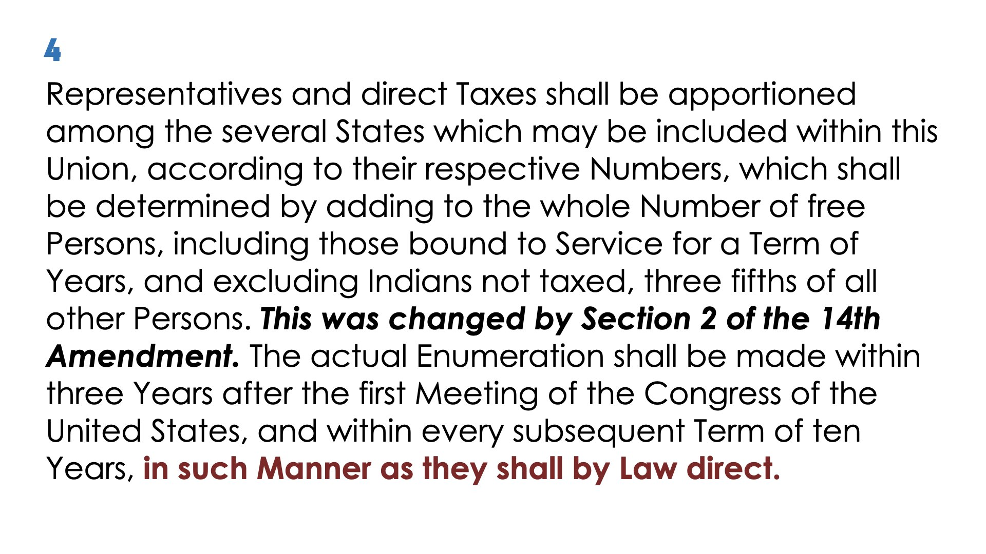

Slide 12
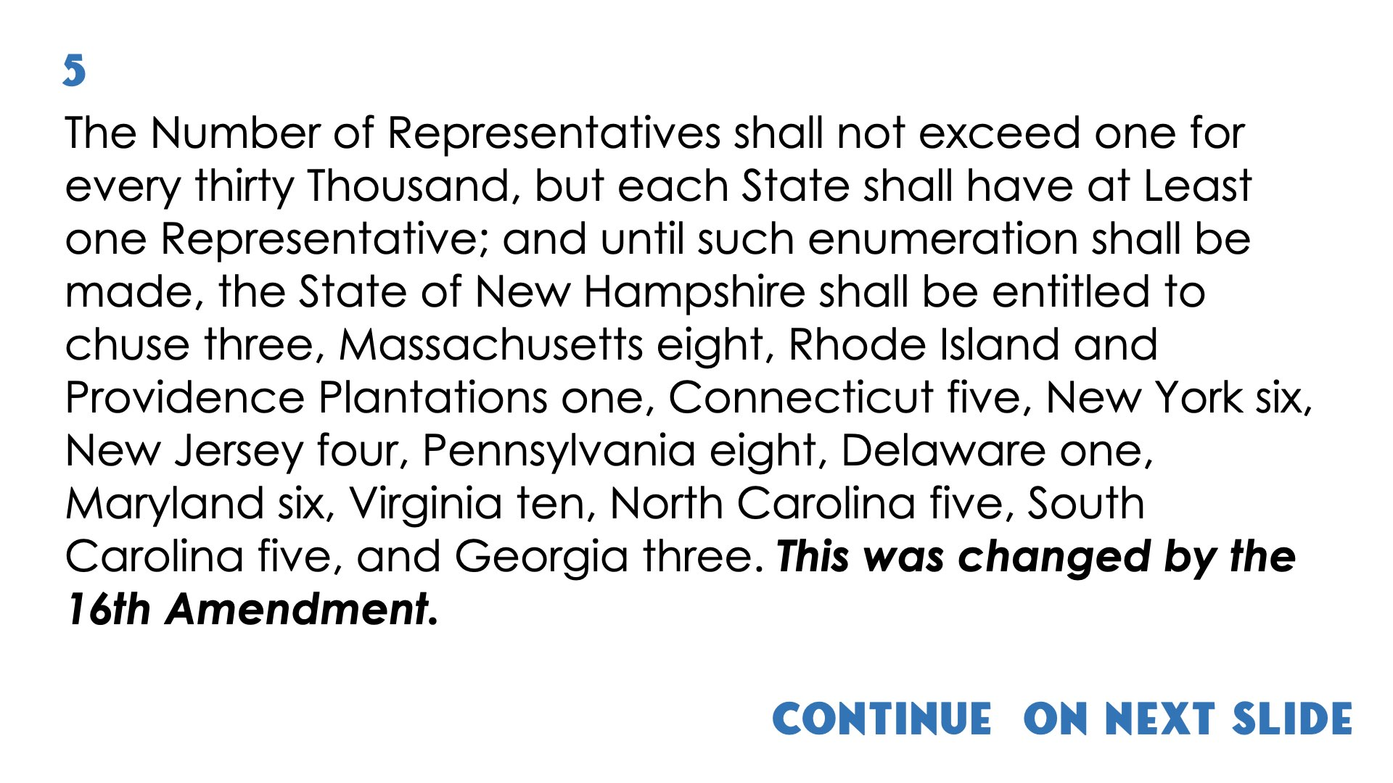
Continue on next slide

Slide 13
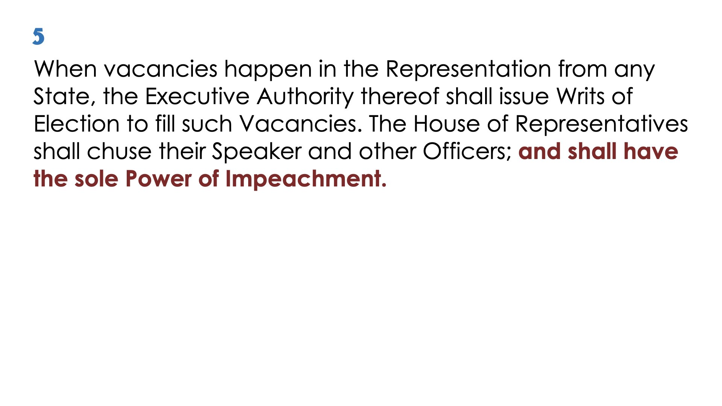

Slide 14
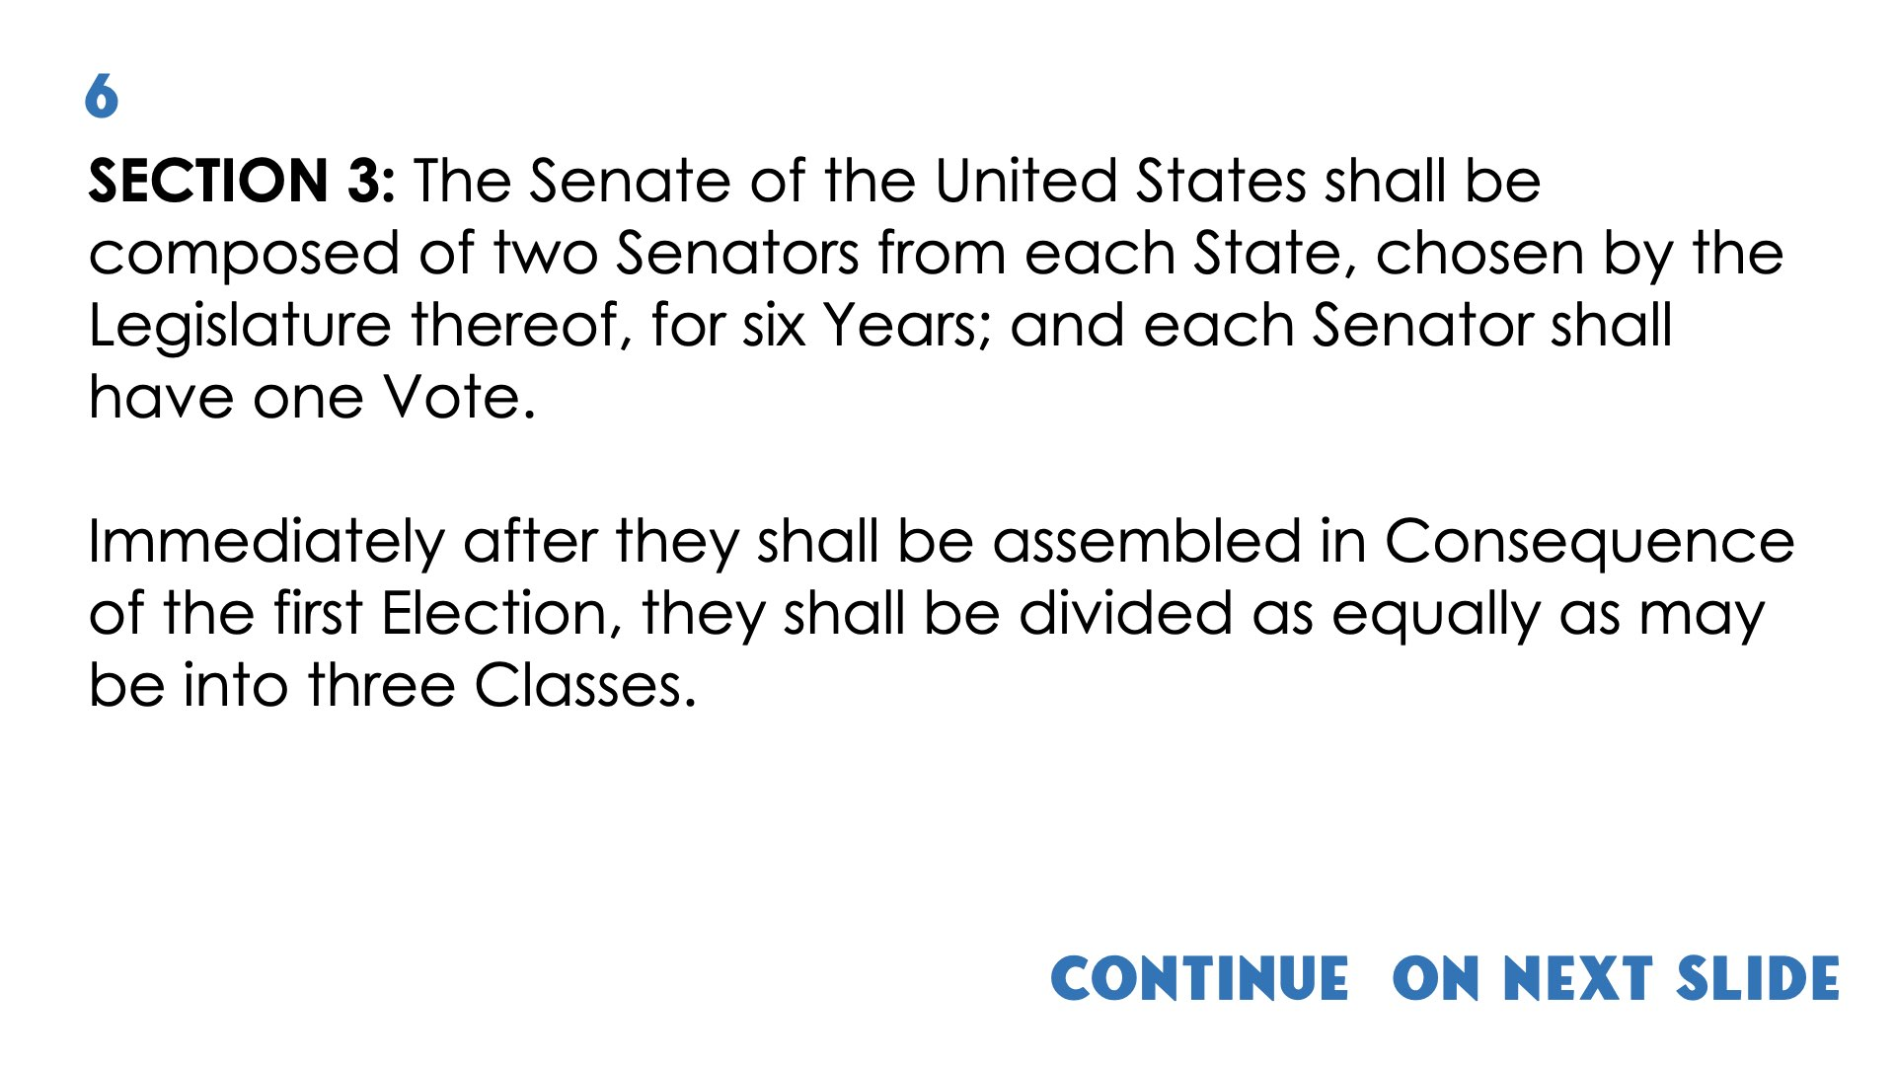
Continue on next slide
(1)

Slide 15
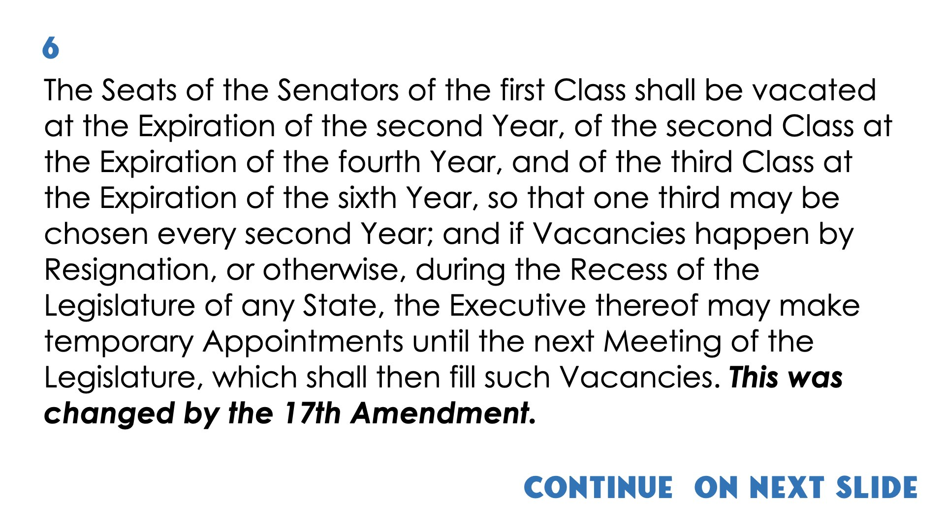
Continue on next slide
(2)

Slide 16
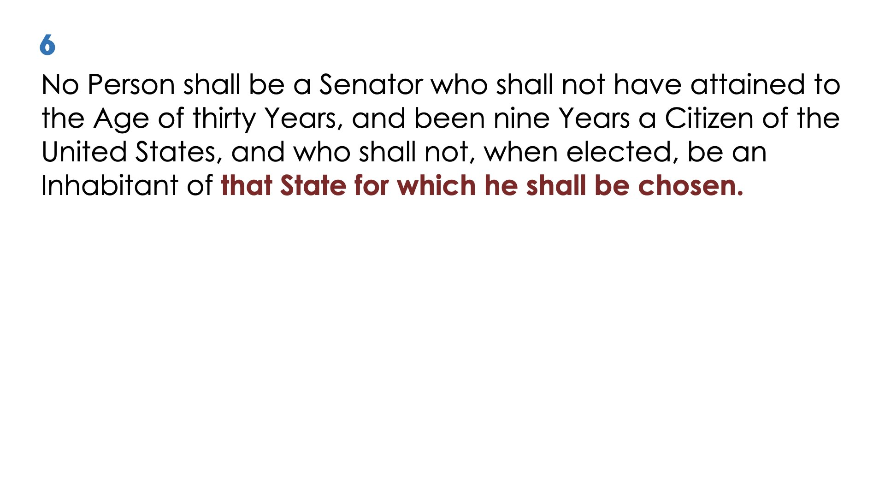
(3)

Slide 17
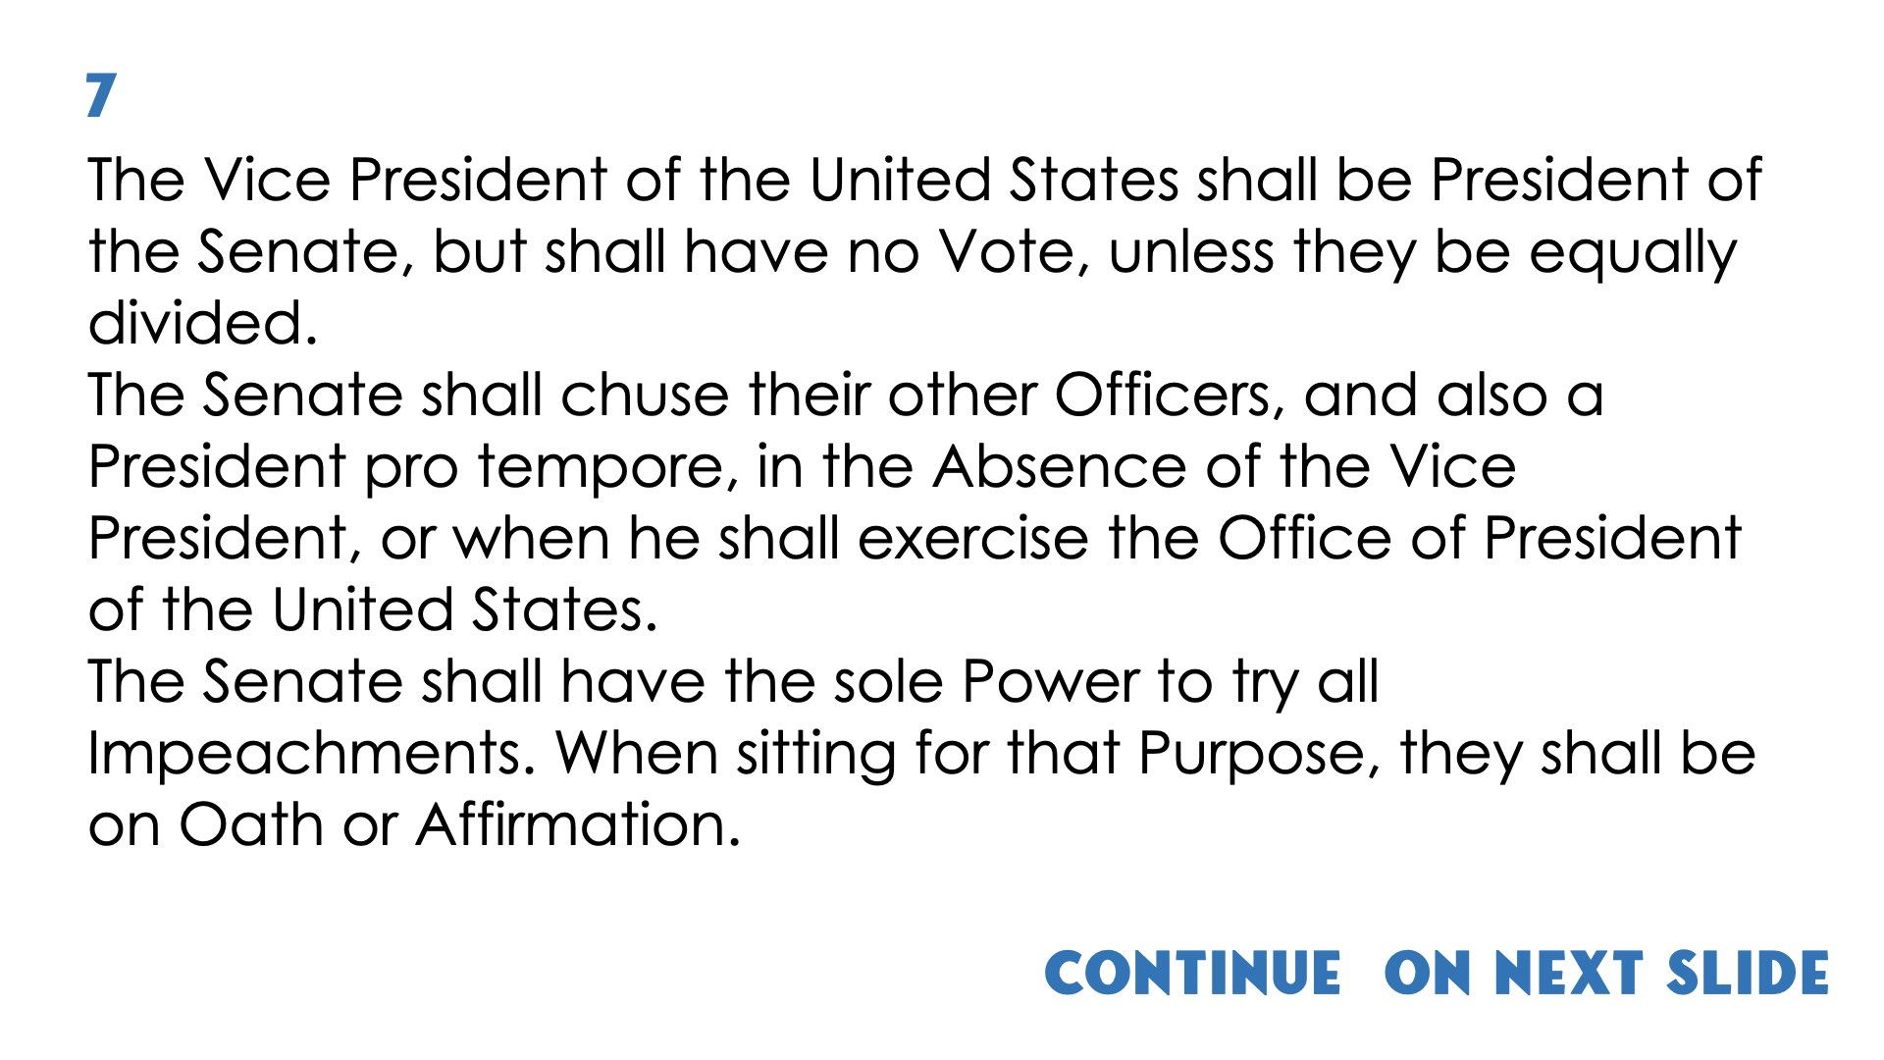
Continue on next slide

Slide 18
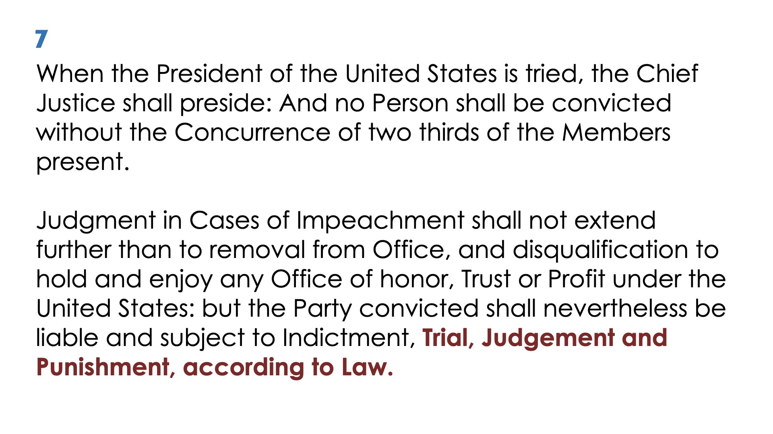

Slide 19
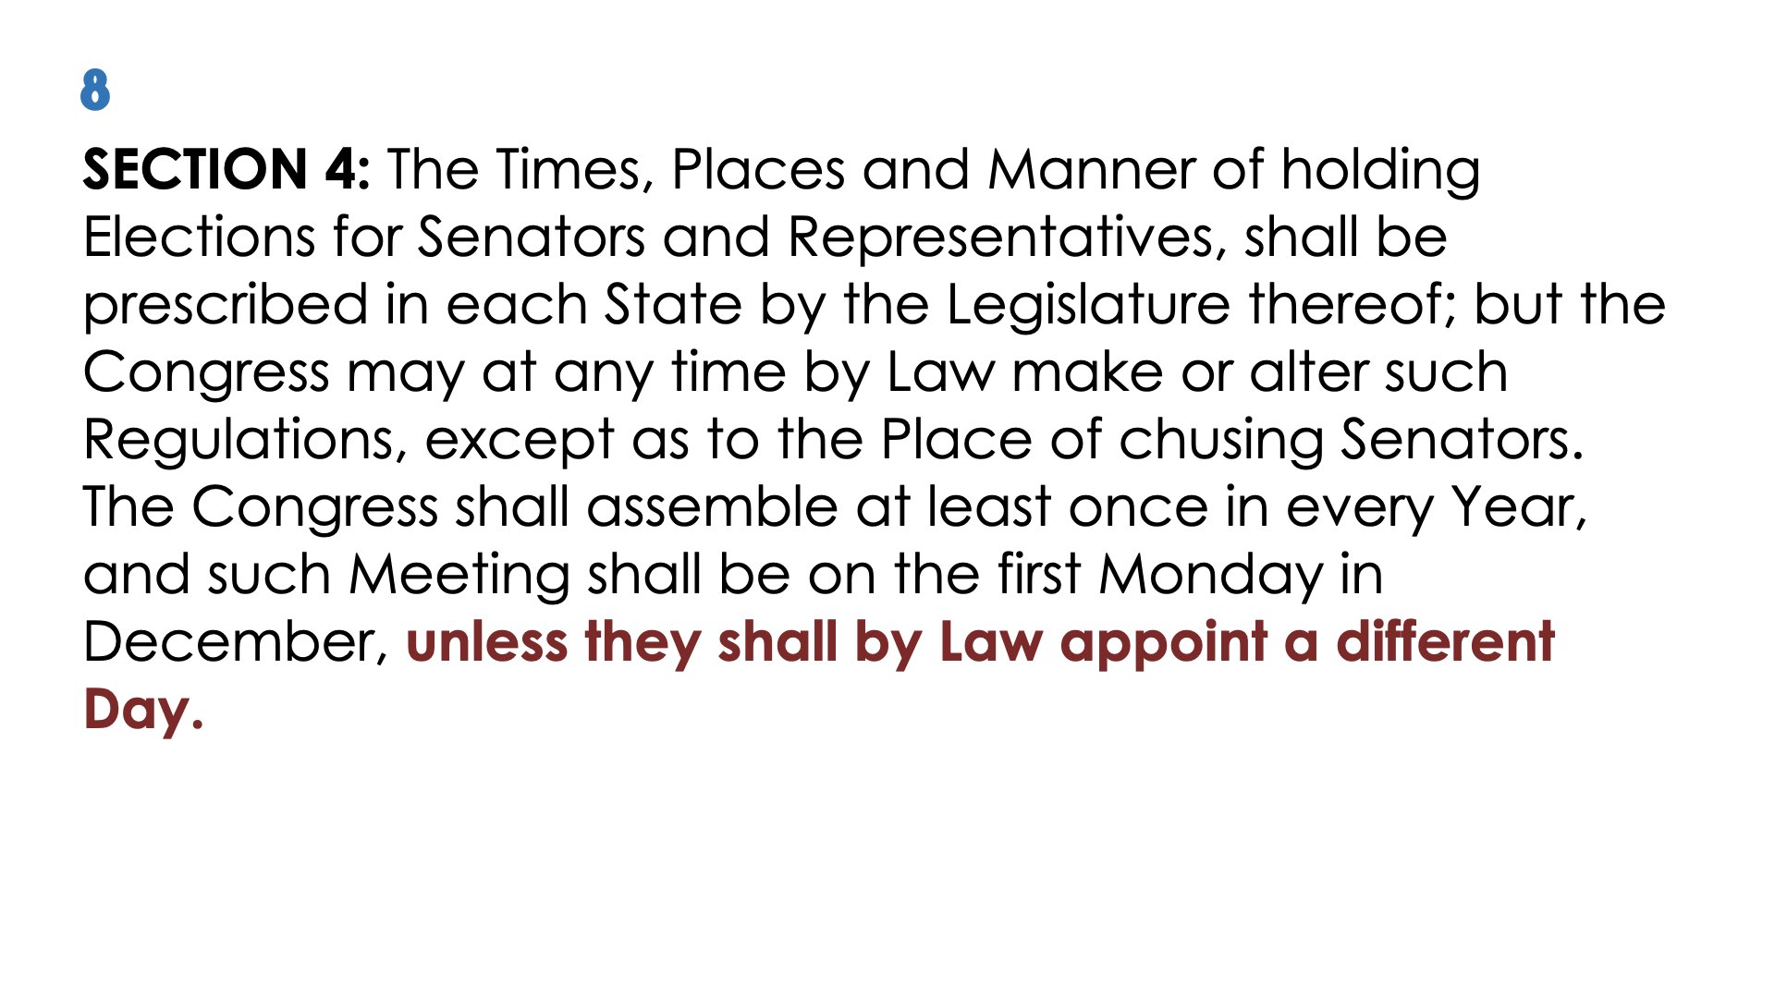

Slide 20
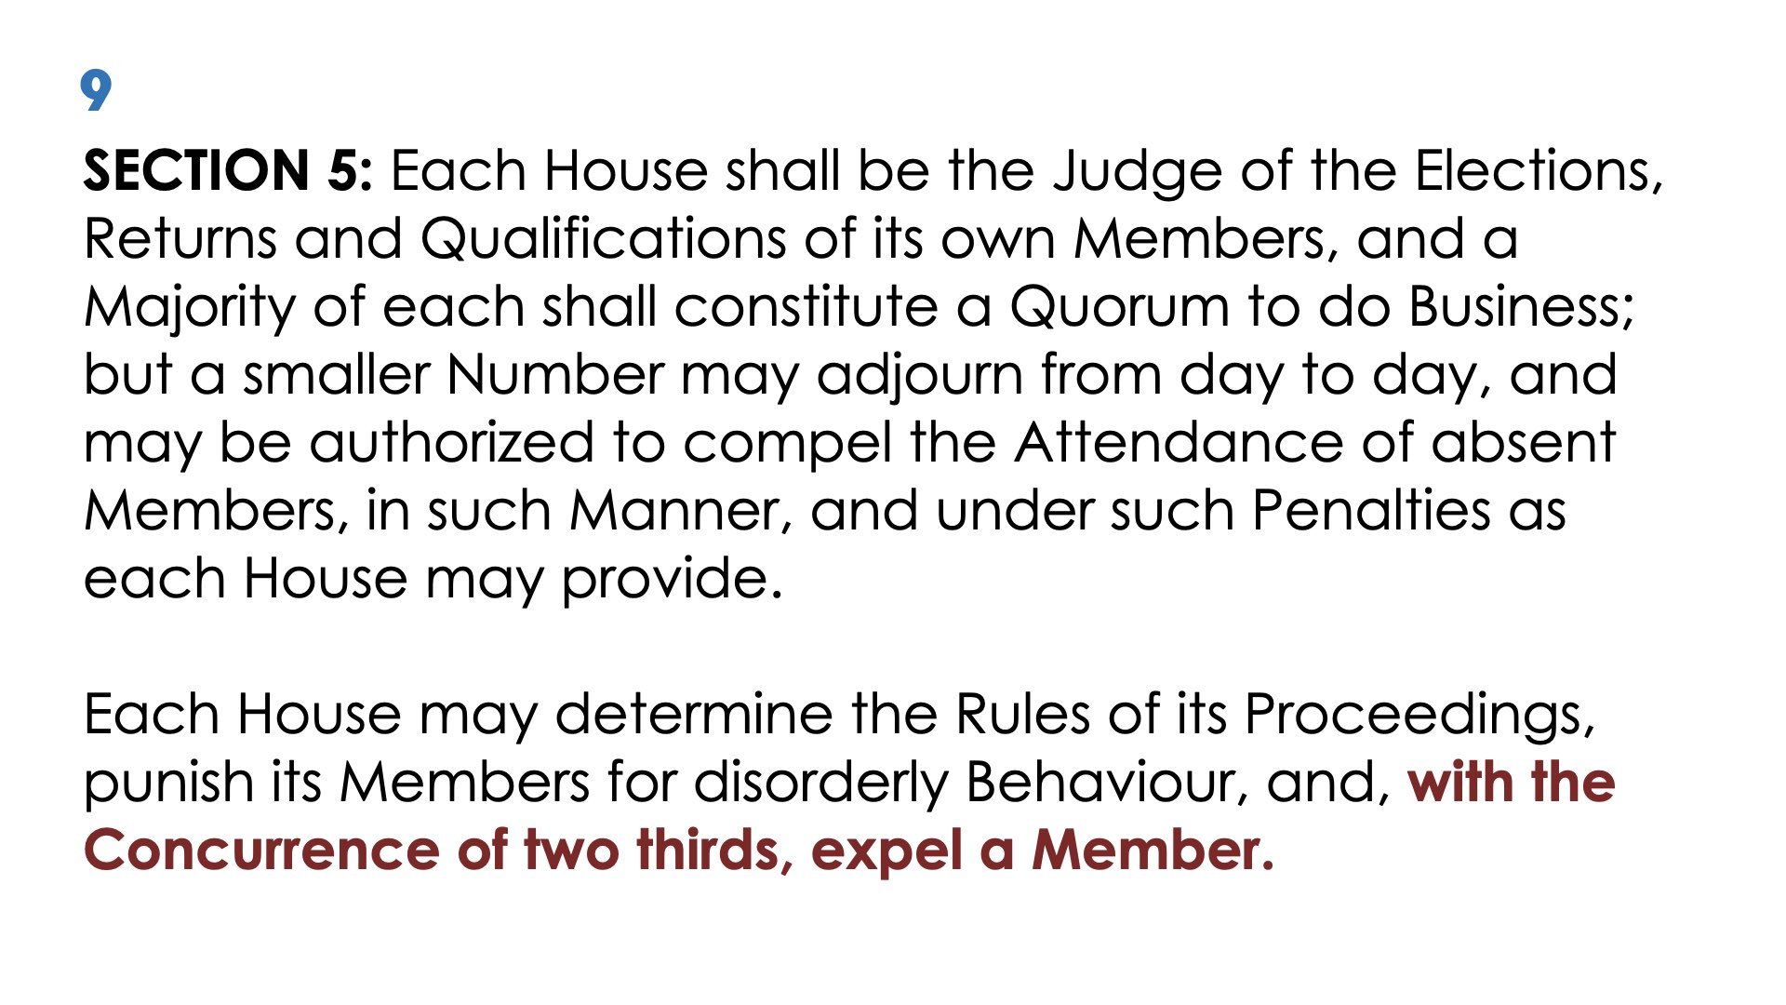

Slide 21
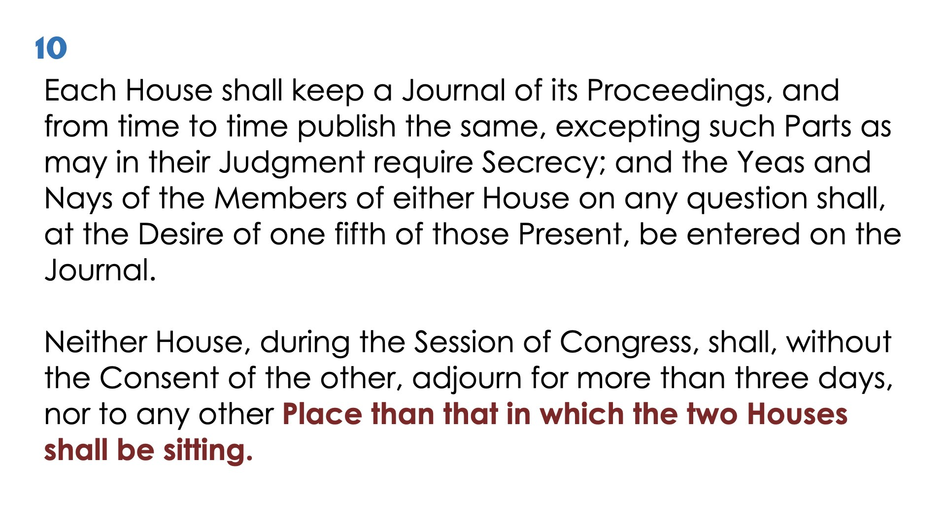

Slide 22
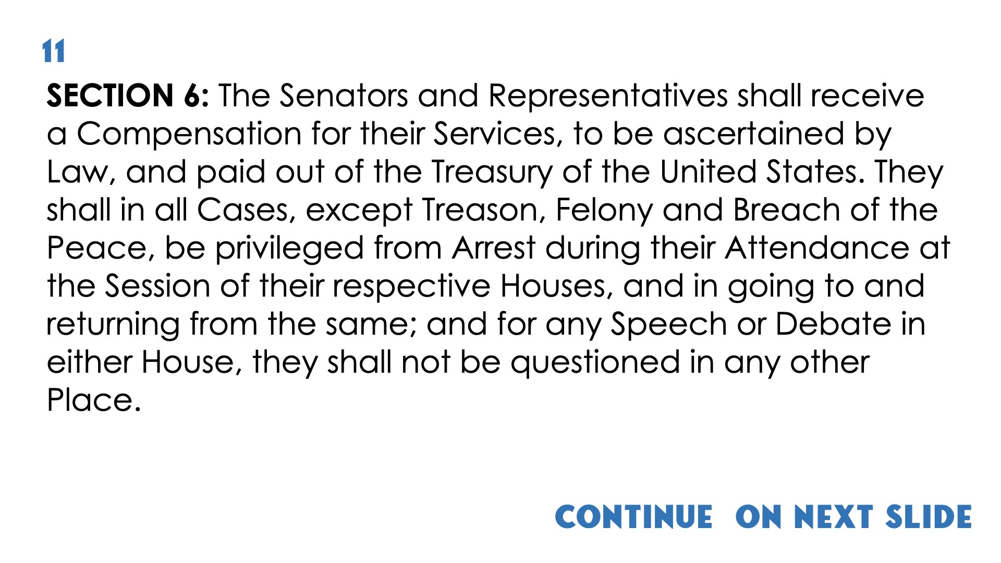
Continue on next slide

Slide 23
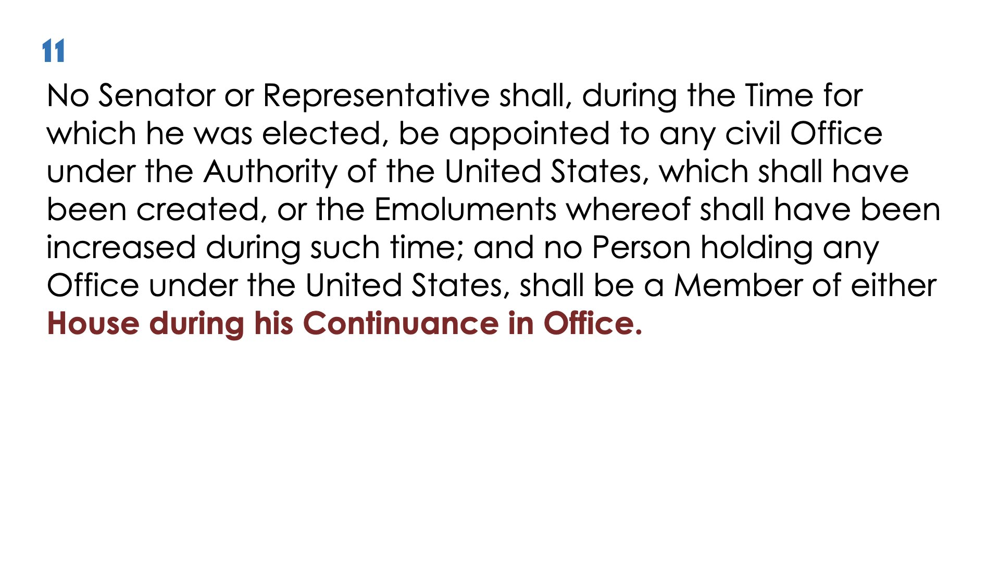

Slide 24
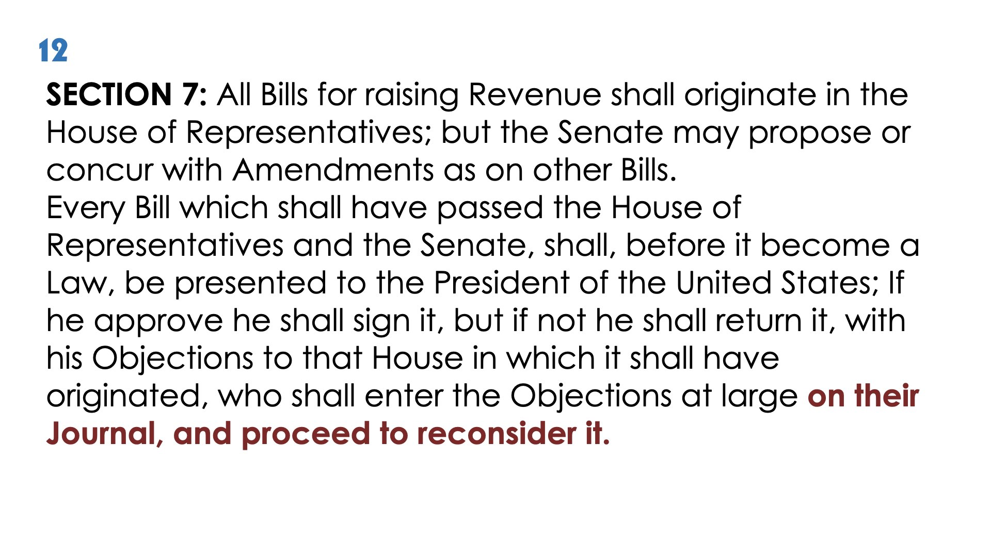

Slide 25
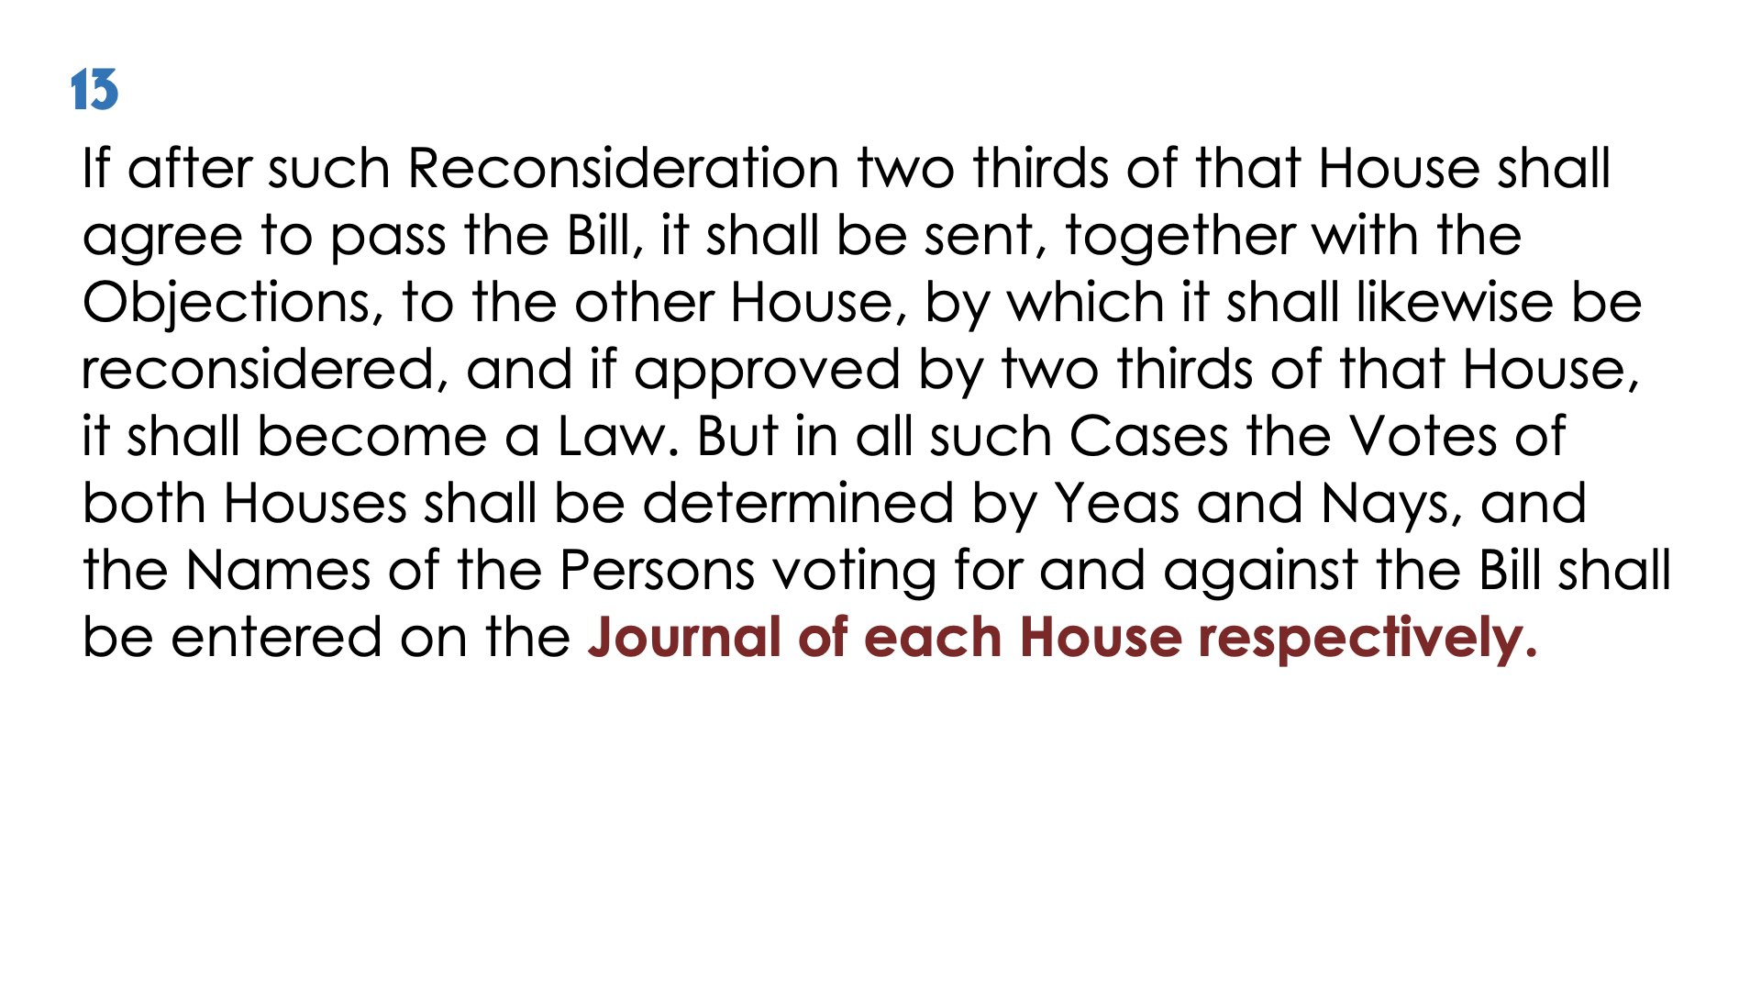

Slide 26
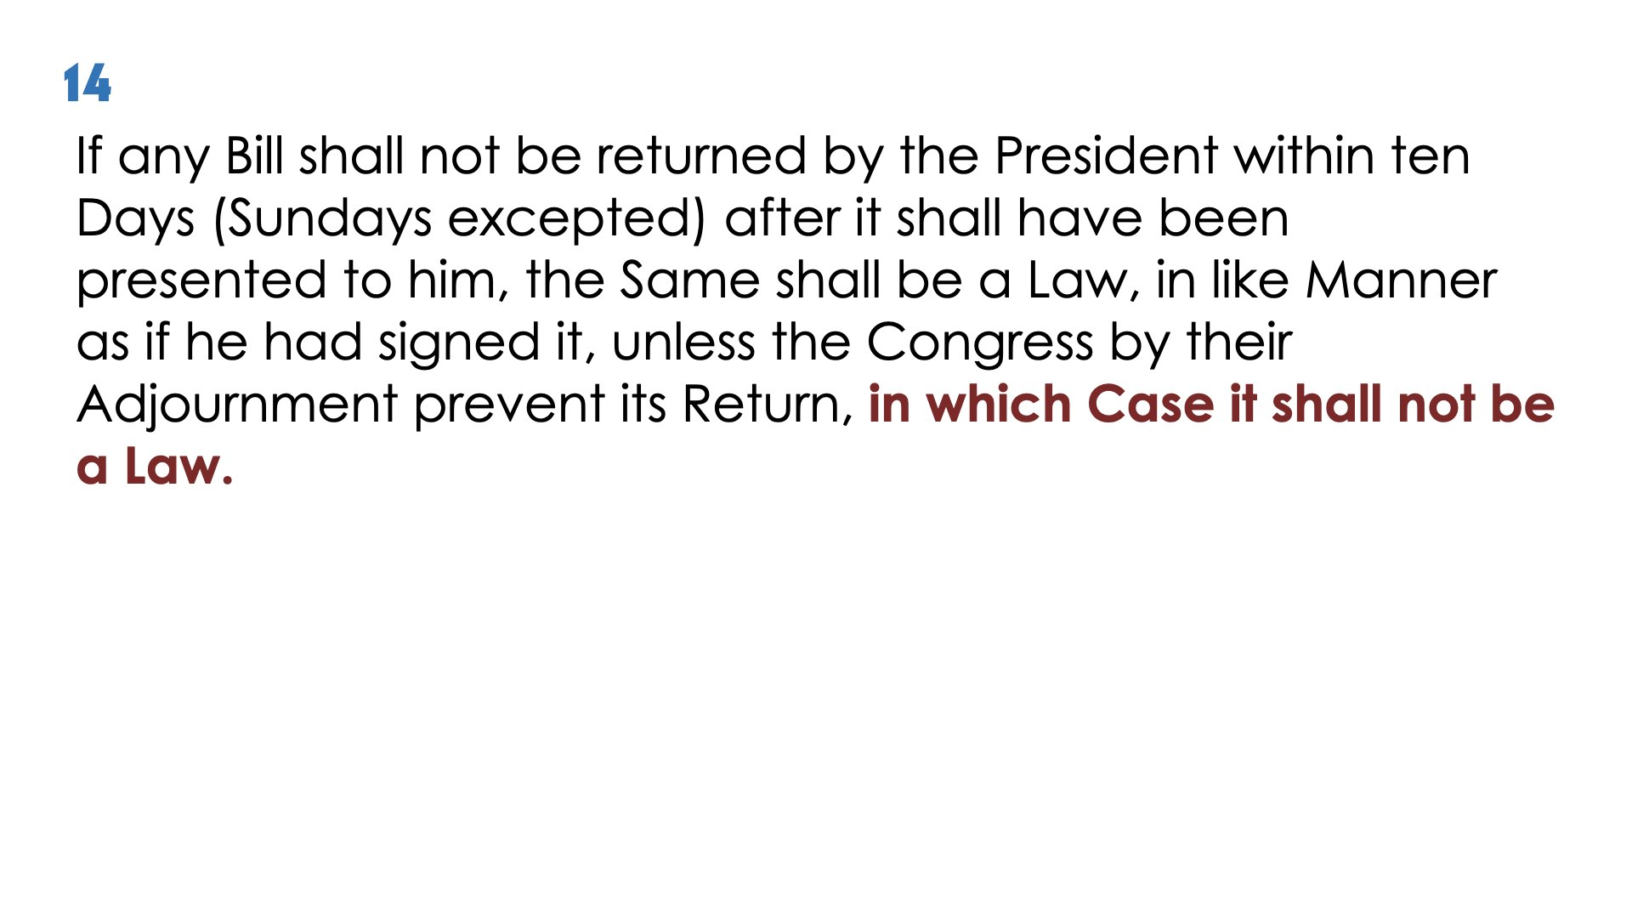

Slide 27
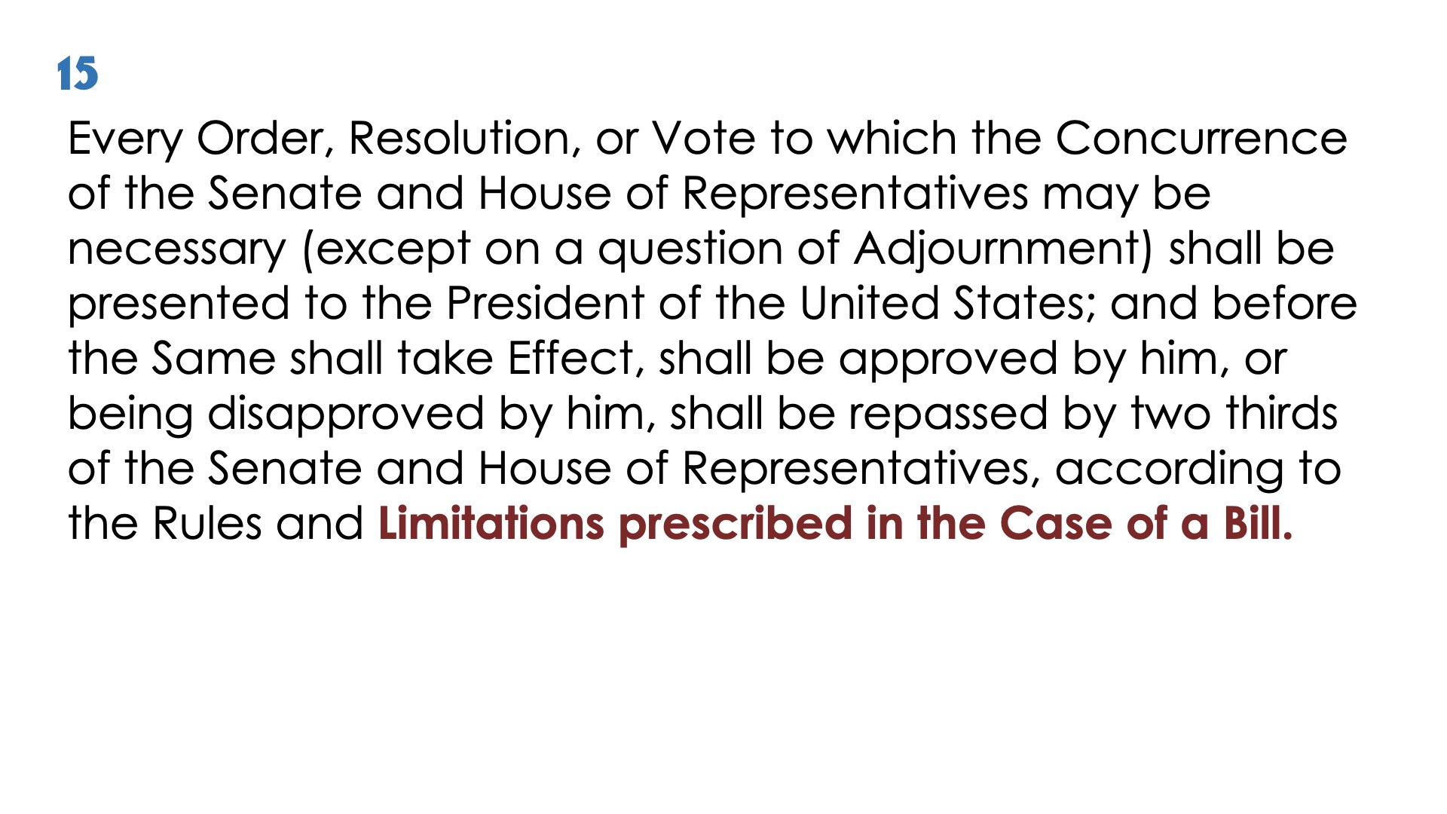

Slide 28
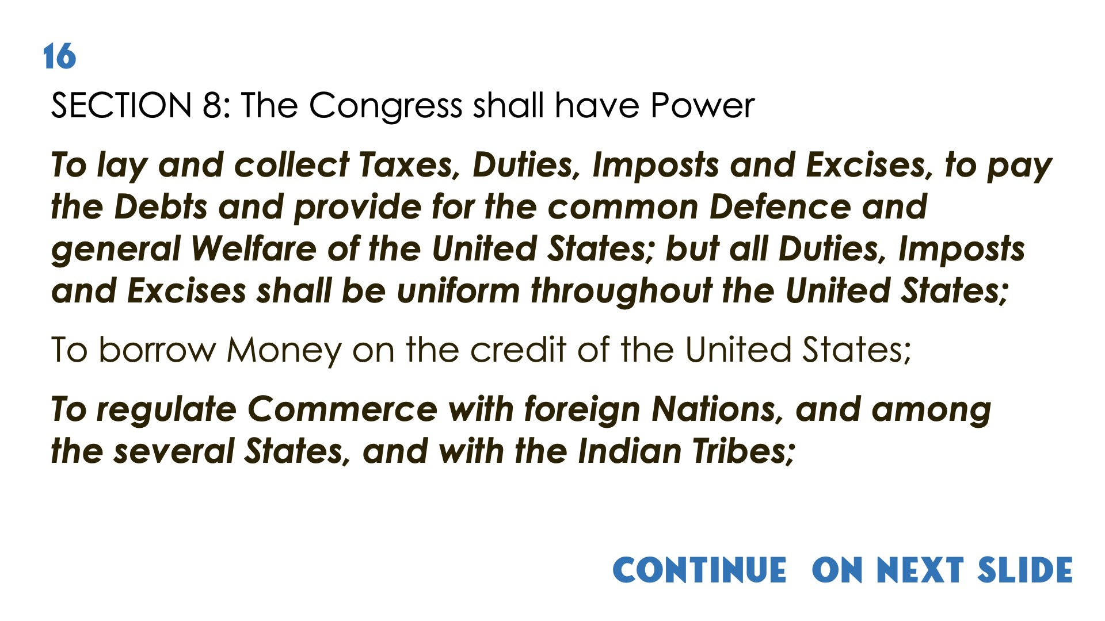
Continue on next slide
(1)

Slide 29
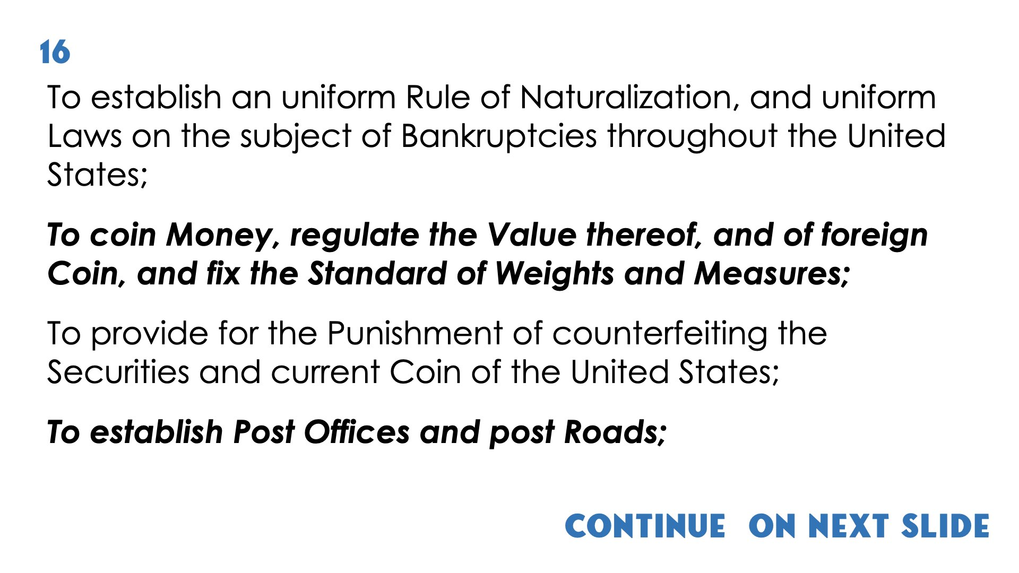
(2)

Slide 30
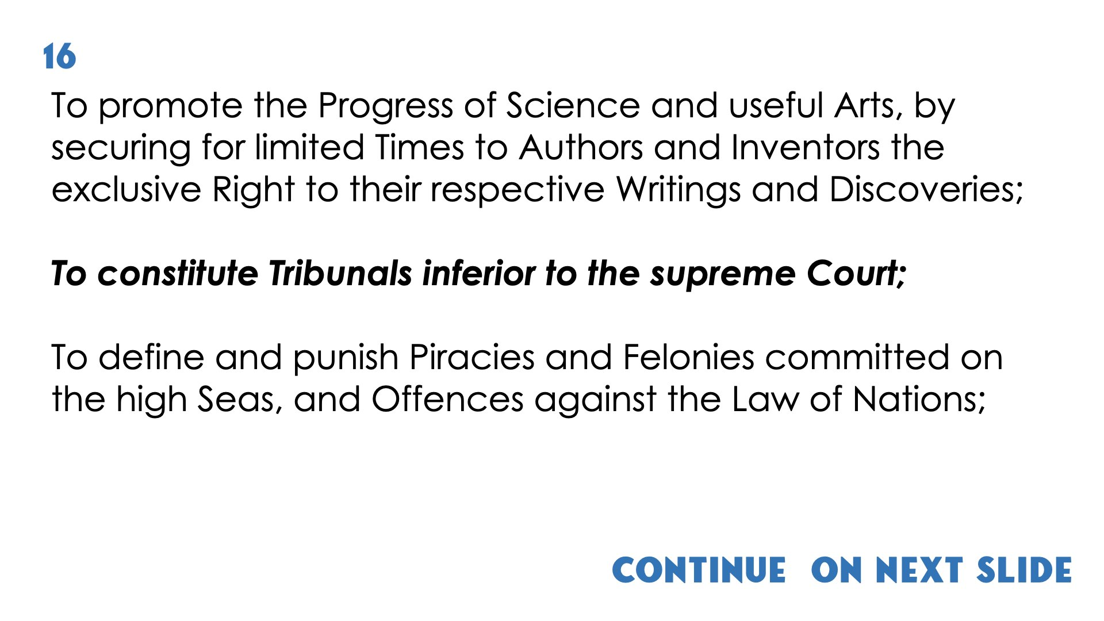
Continue on next slide
(3)

Slide 31
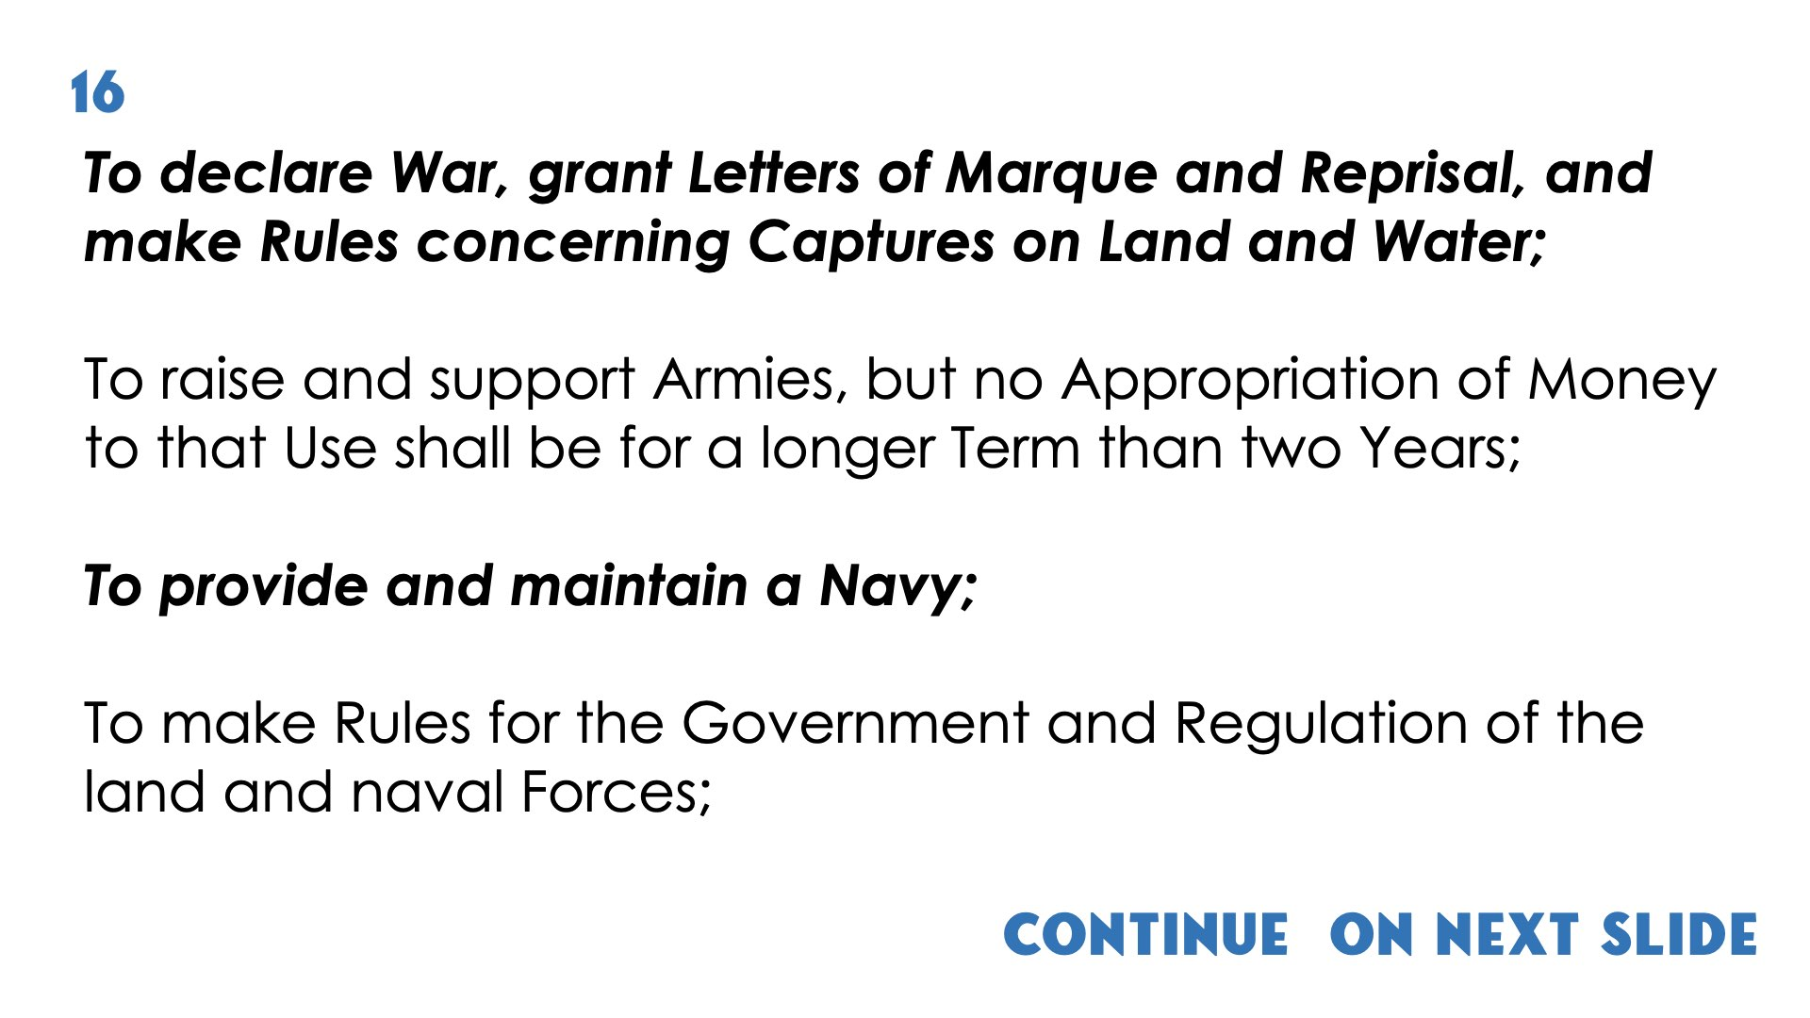
Continue on next slide
(4)

Slide 32
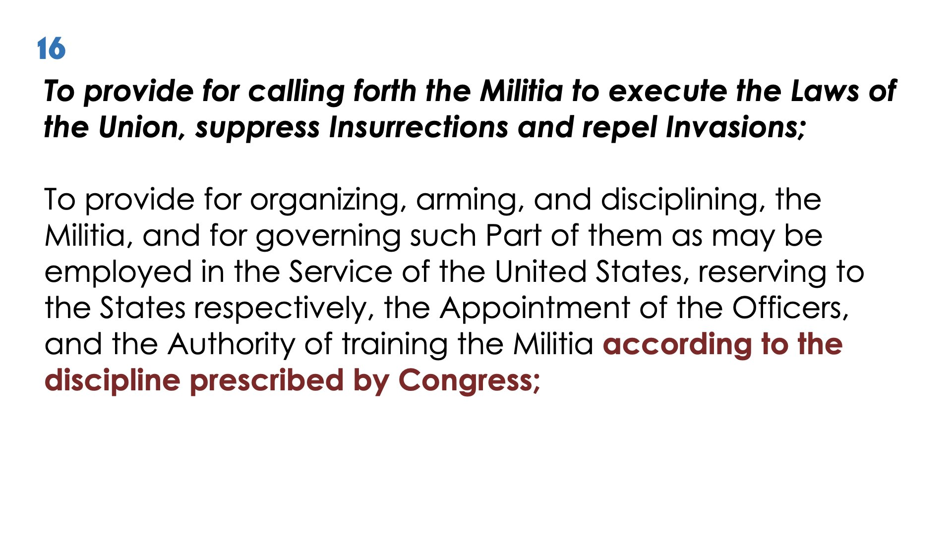
(5)

Slide 33
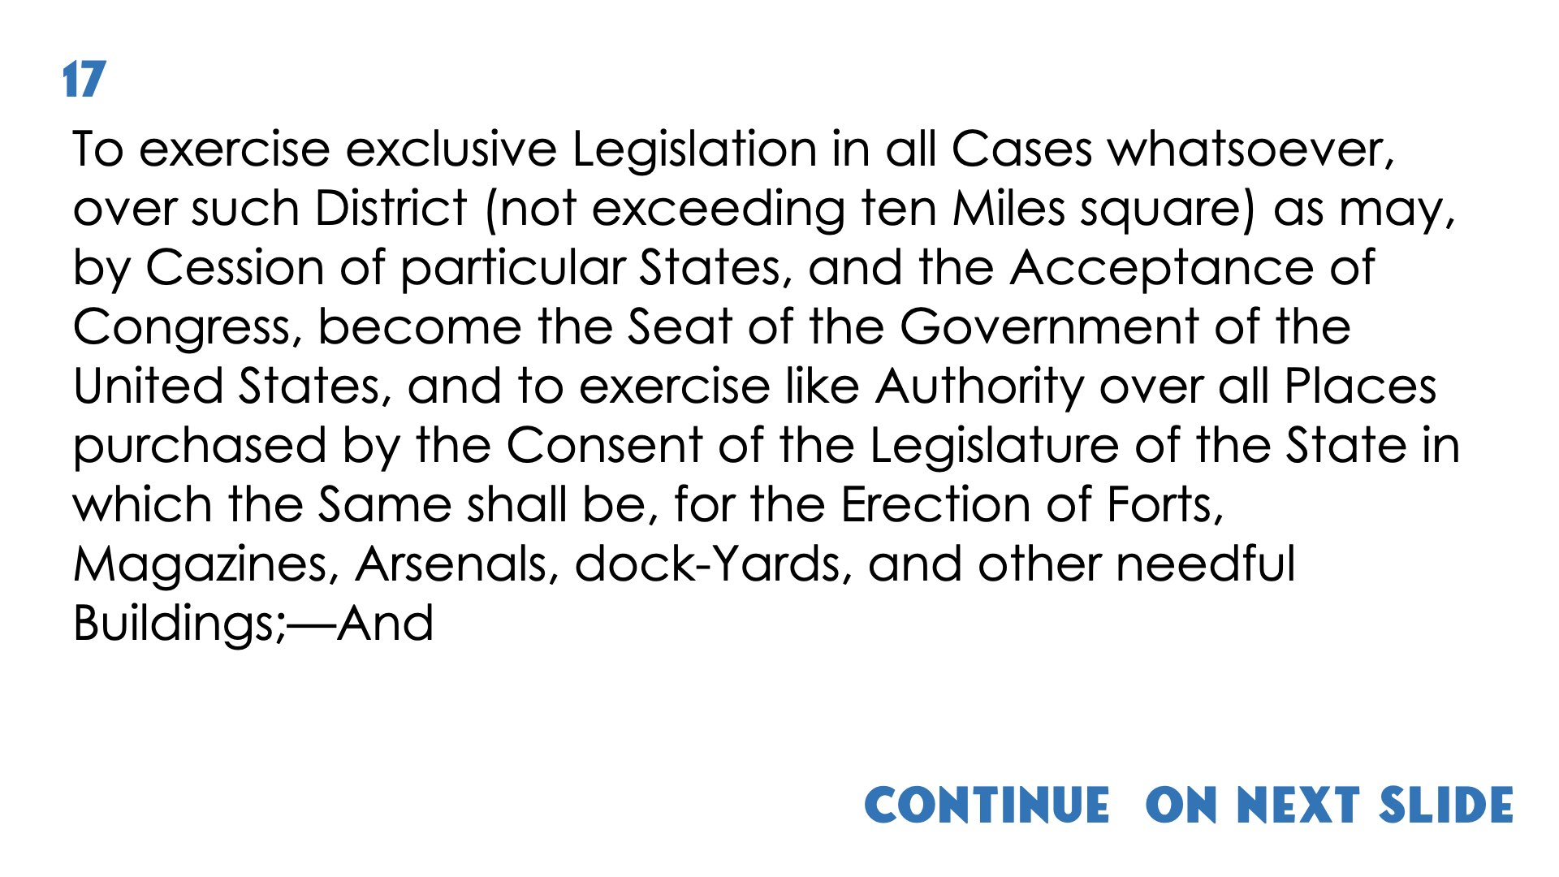
Continue on next slide

Slide 34
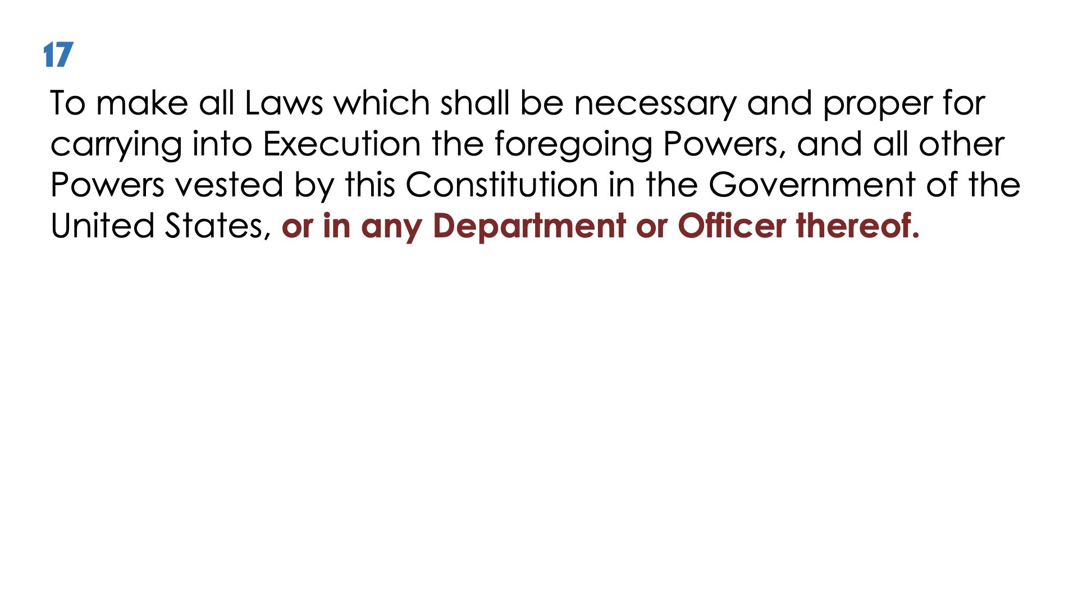

Slide 35
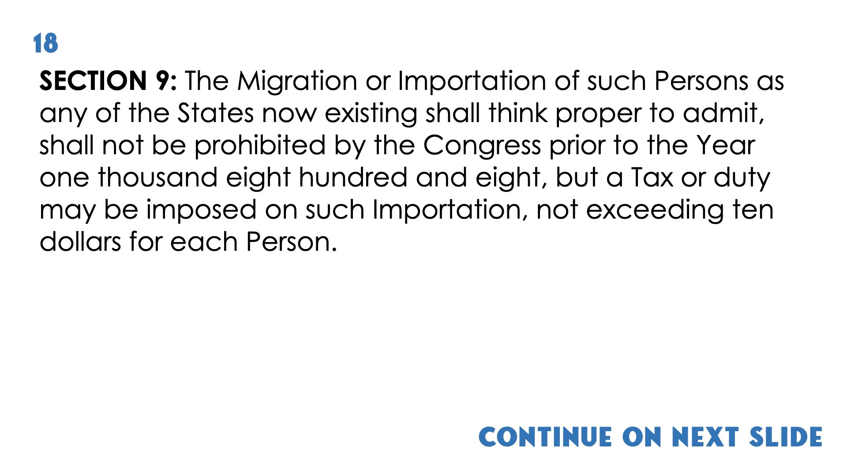
Continue on next slide

Slide 36
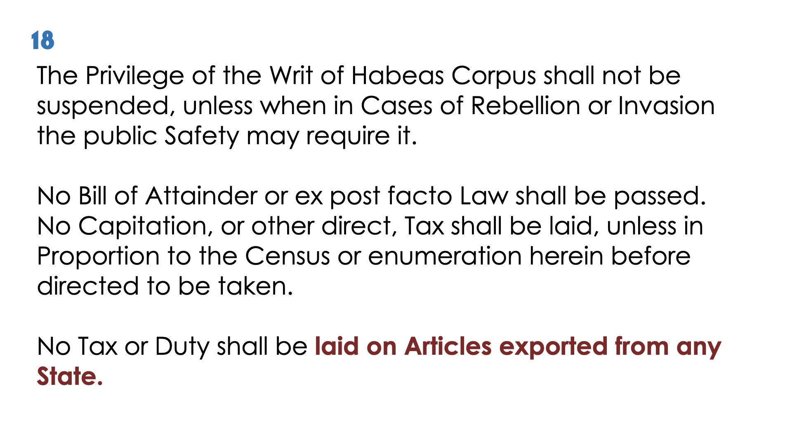

Slide 37
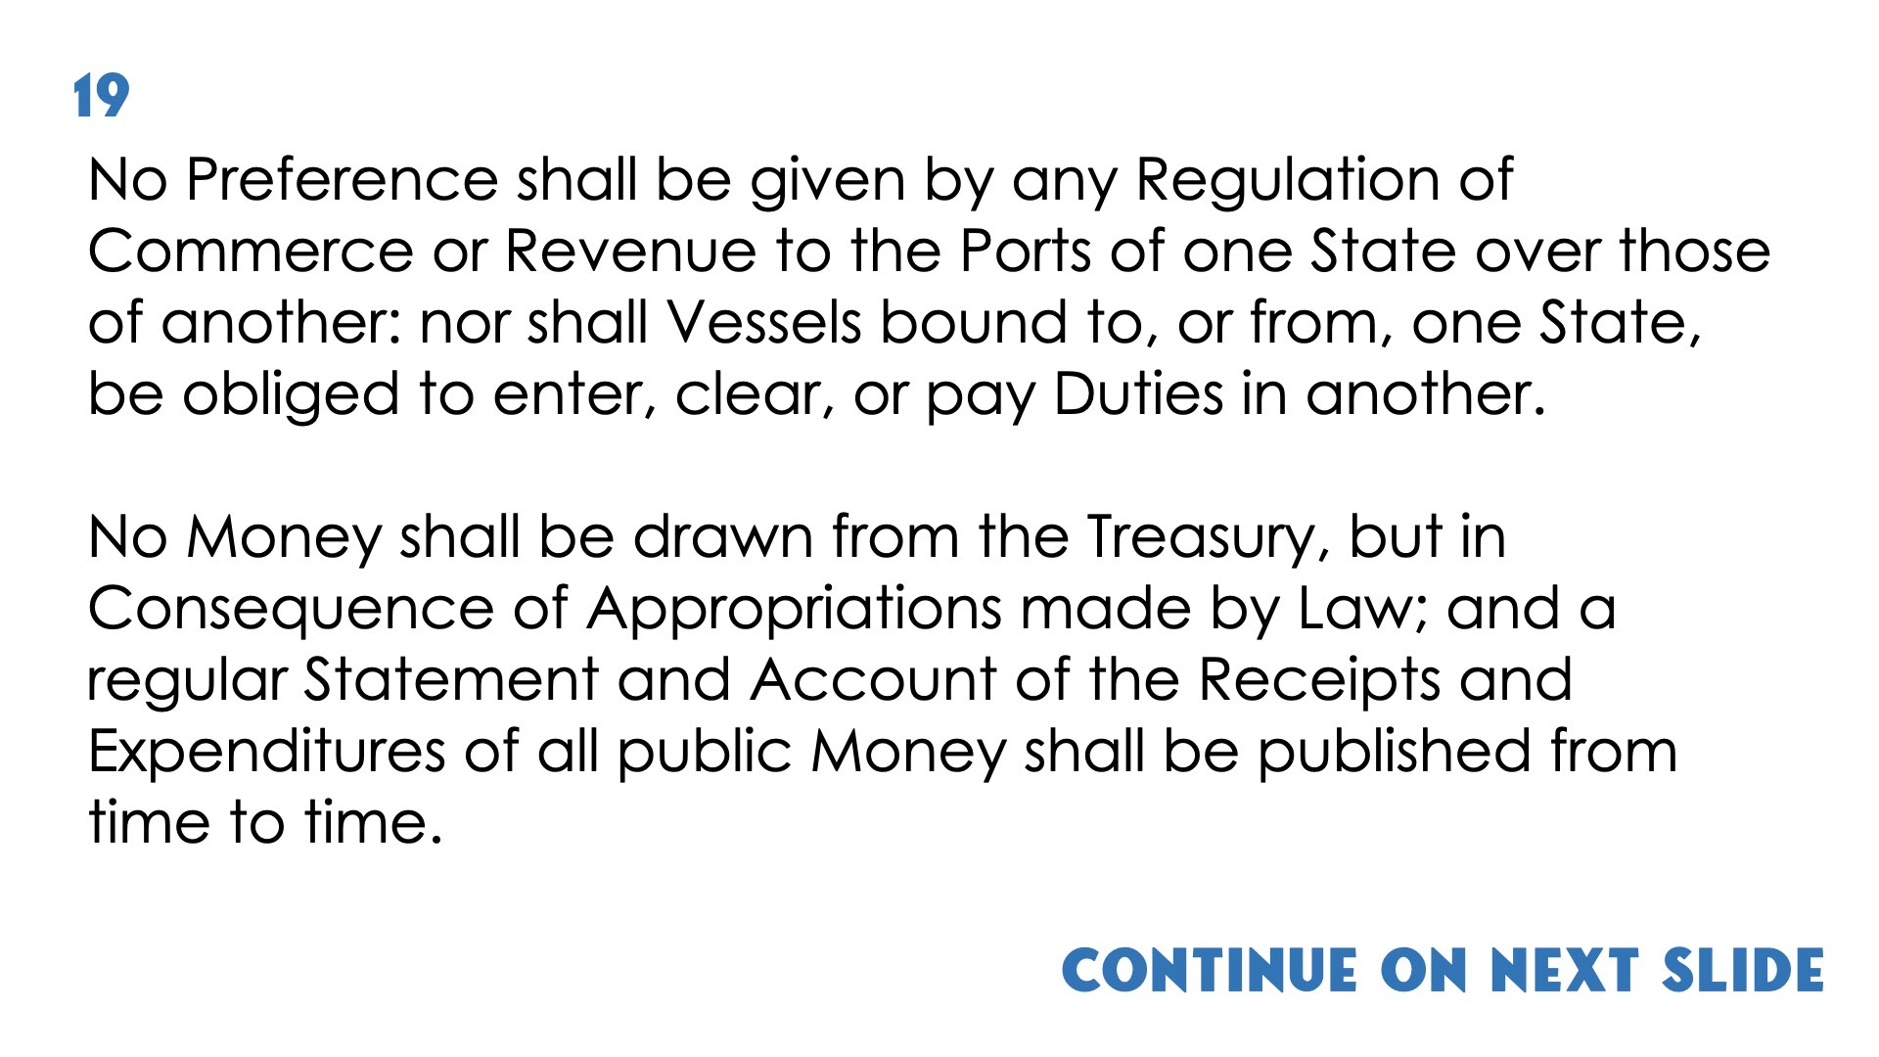
Continue on next slide

Slide 38
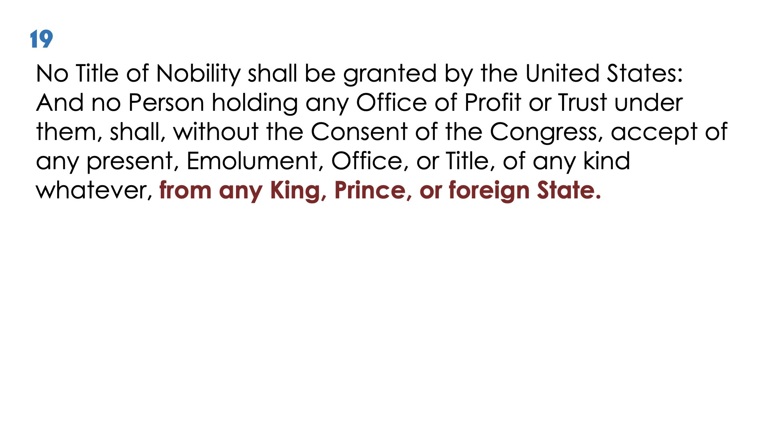

Slide 39
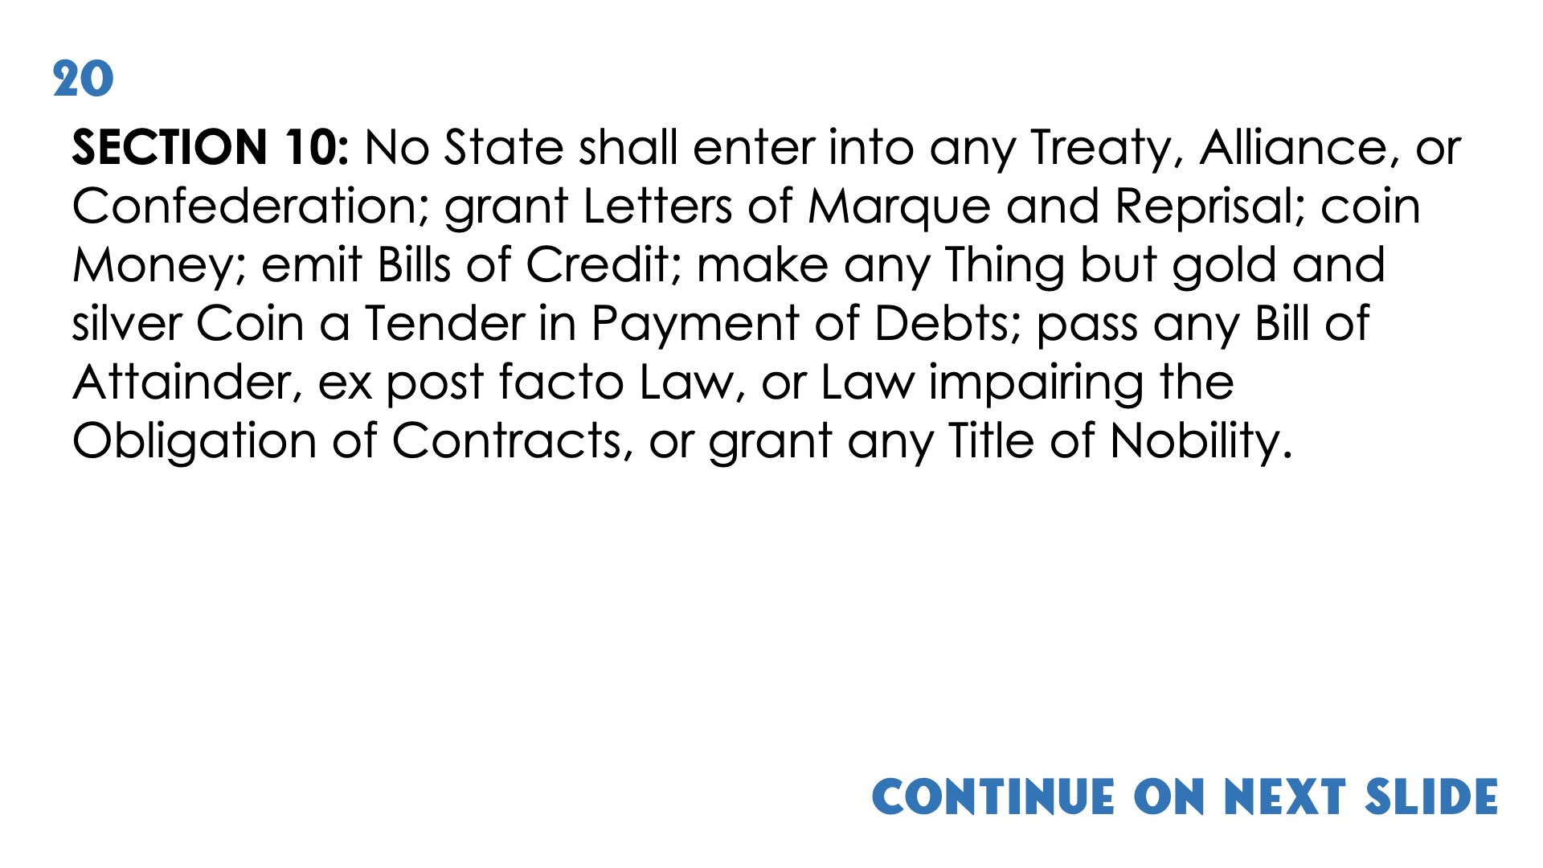
Continue on next slide

Slide 40
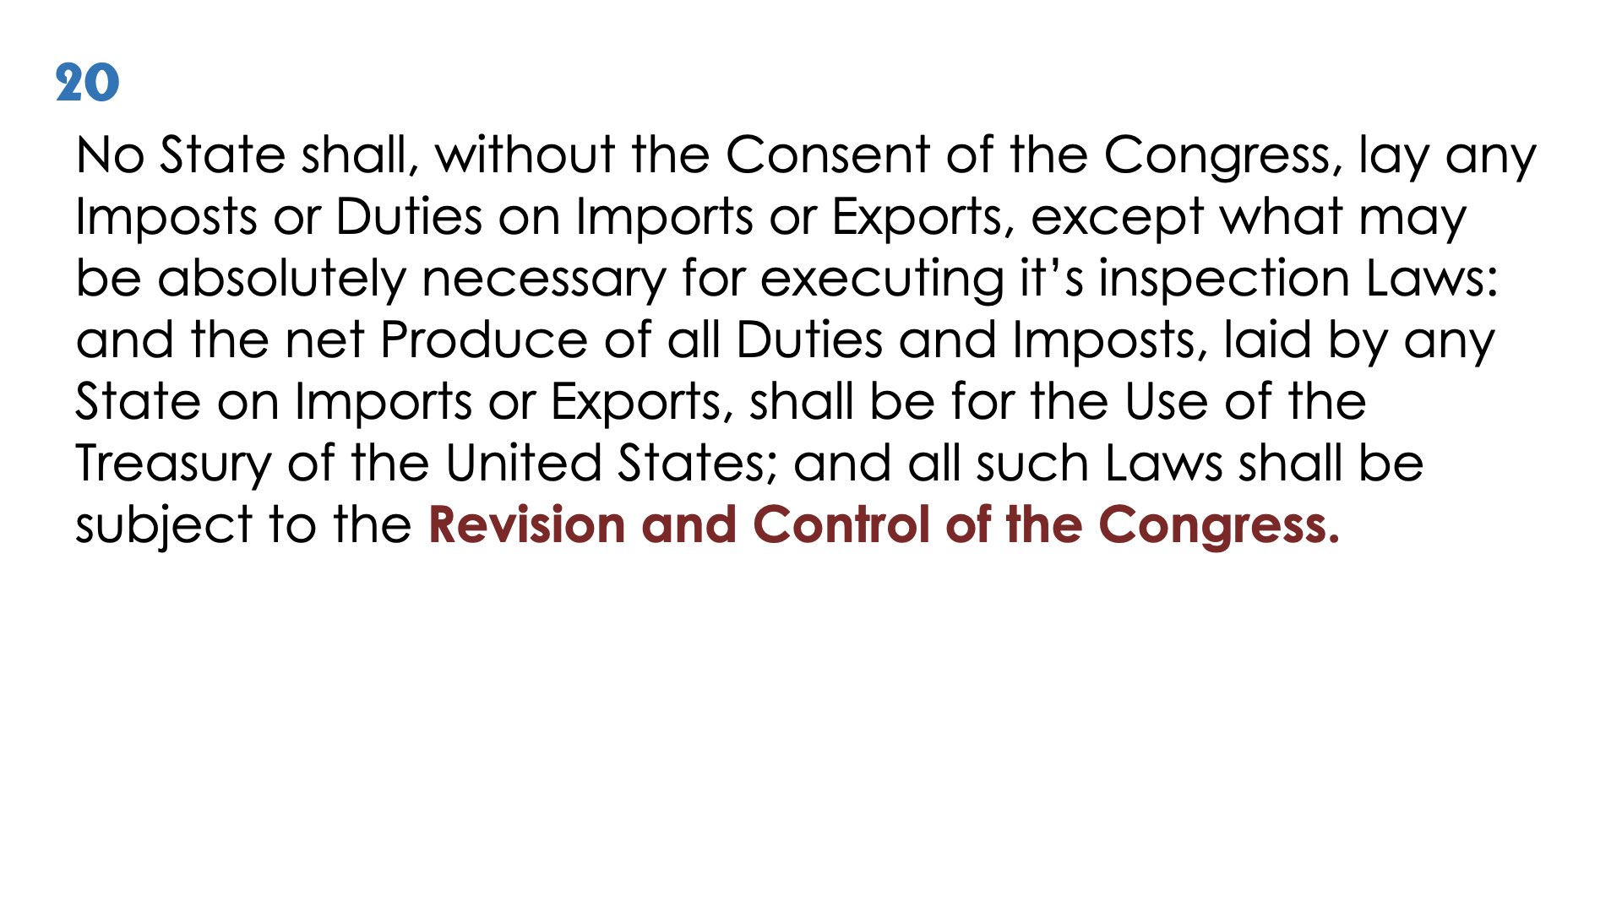

Slide 41
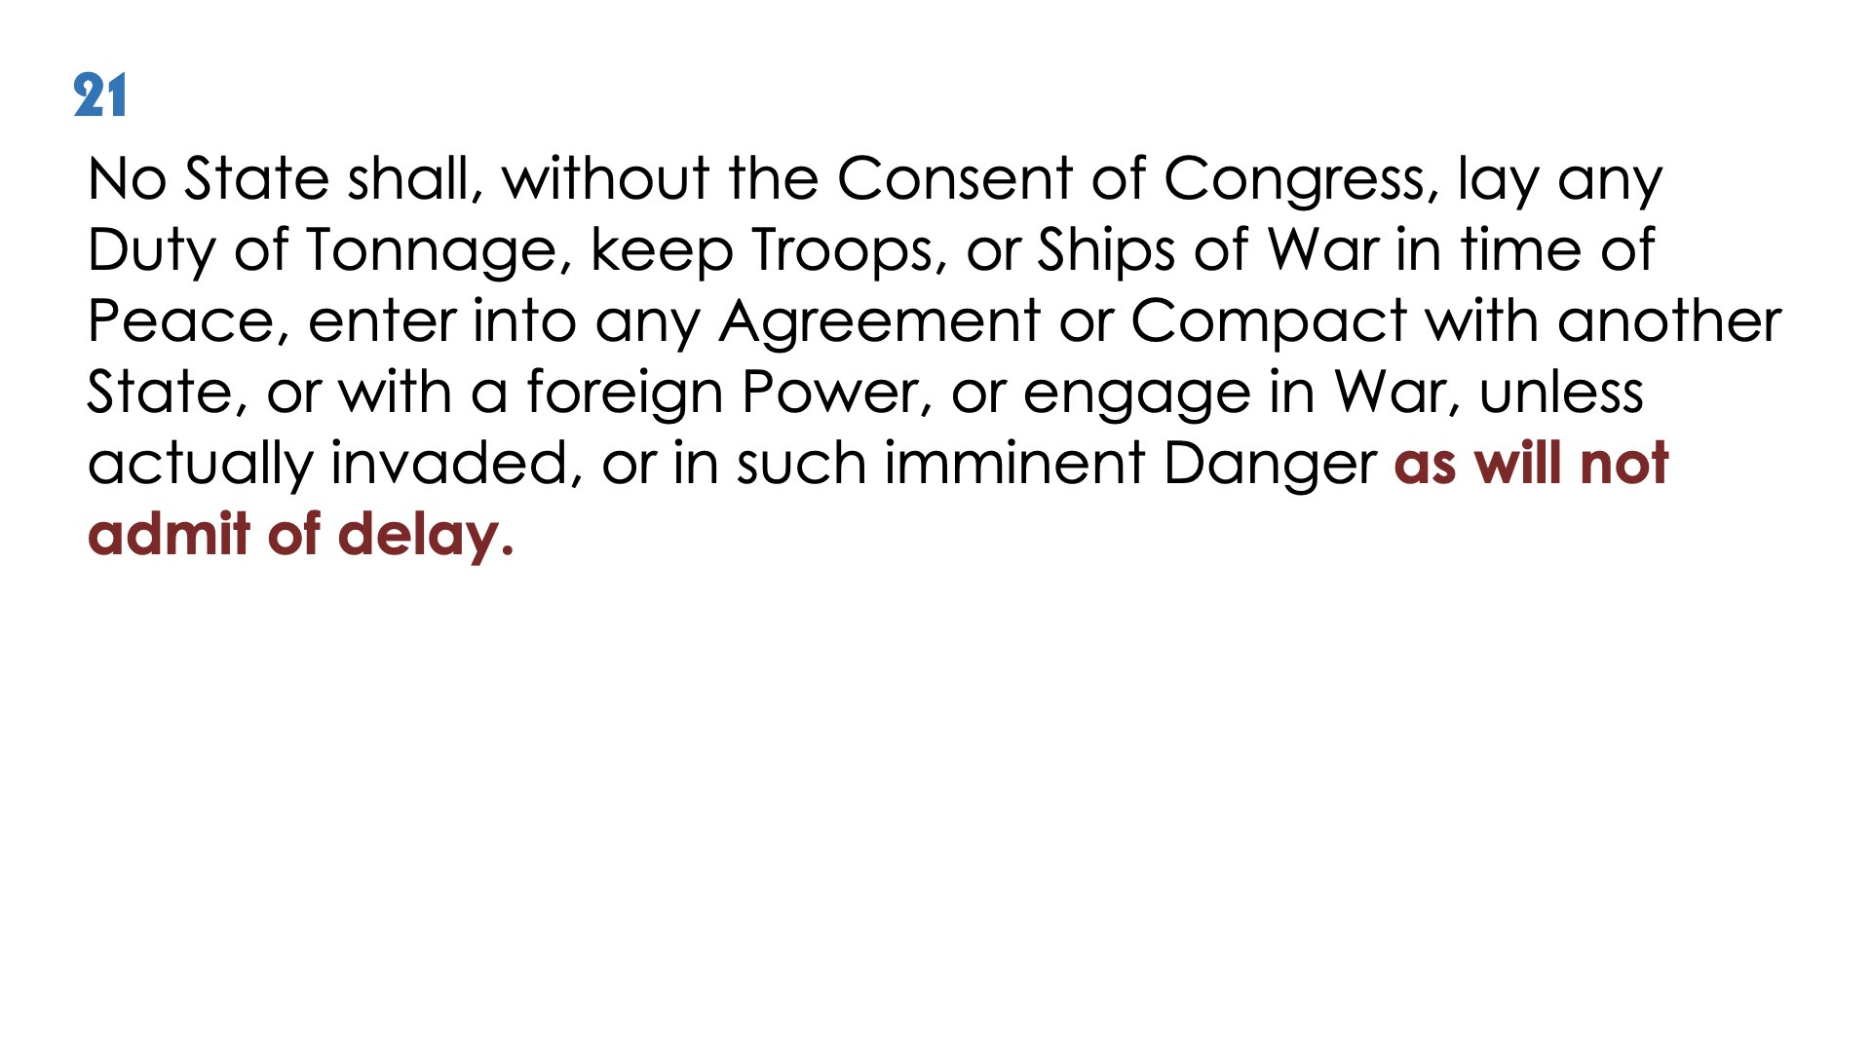

Slide 42
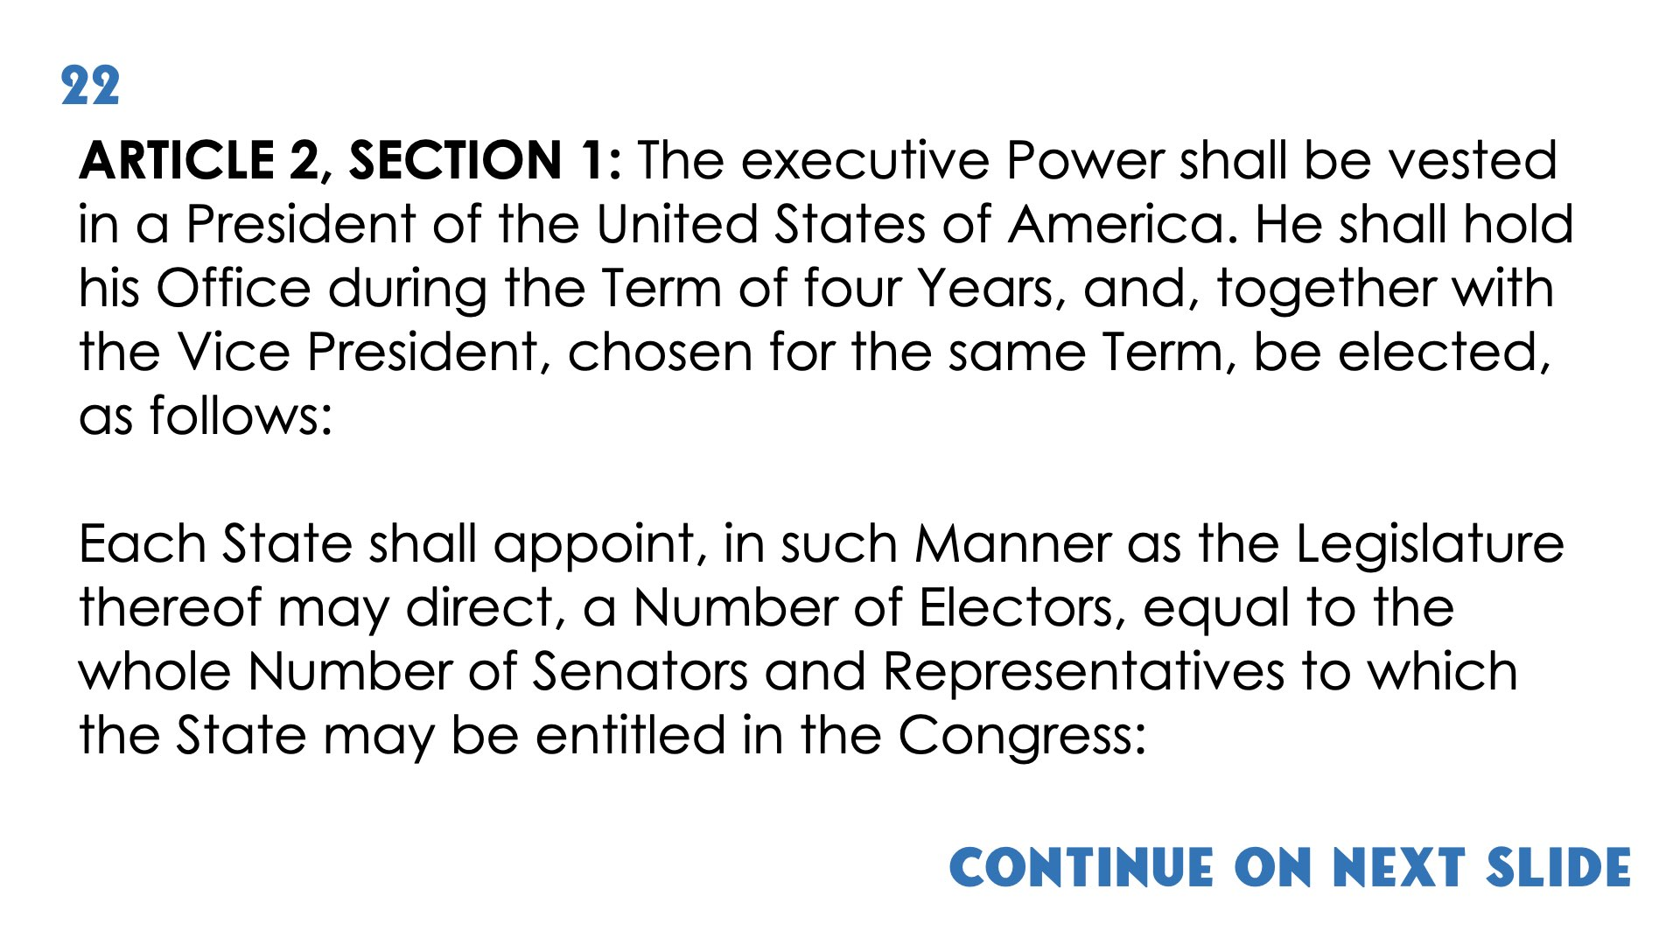
Continue on next slide
(1)

Slide 43
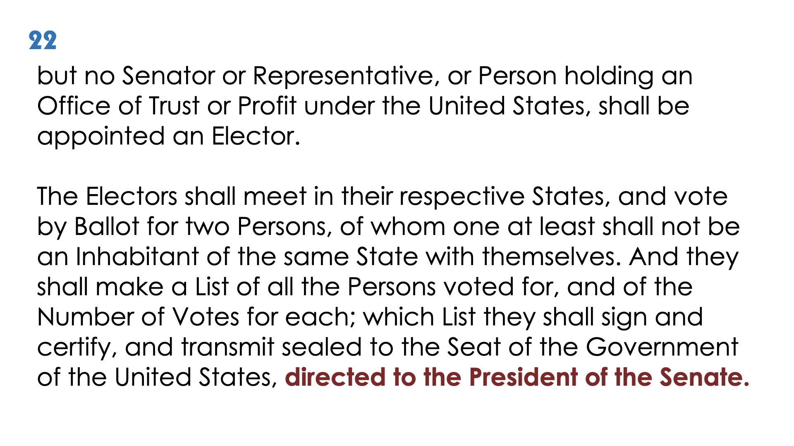
(2)

Slide 44
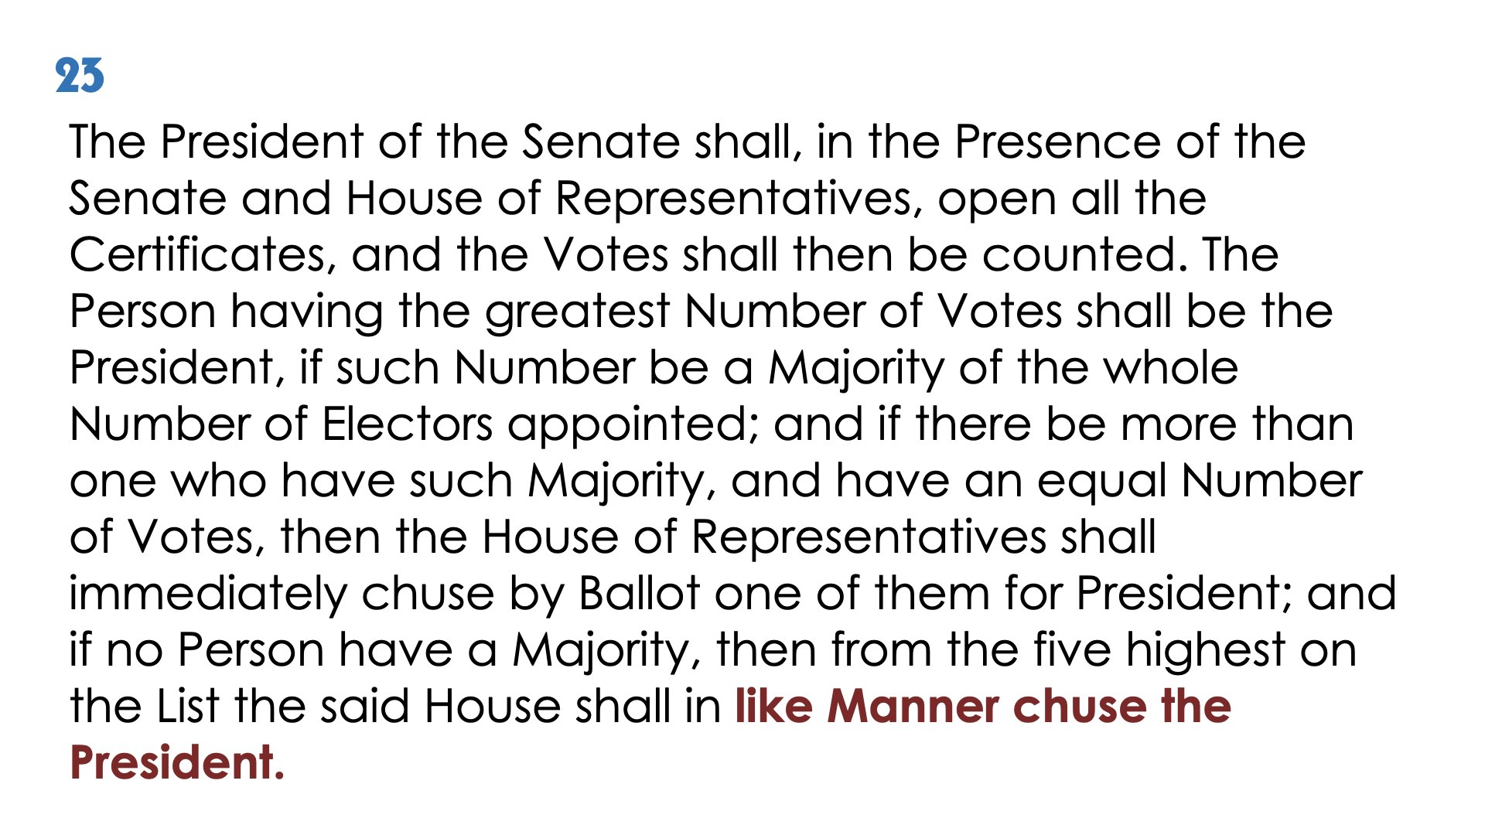
(3)

Slide 45
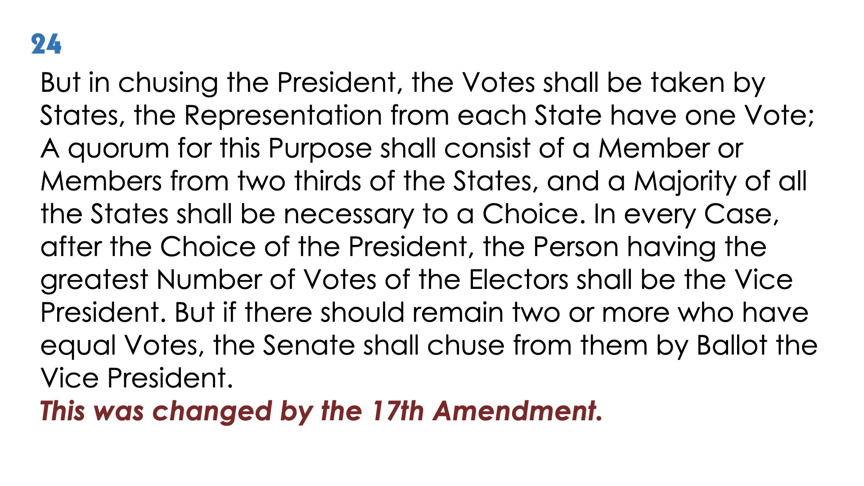

Slide 46
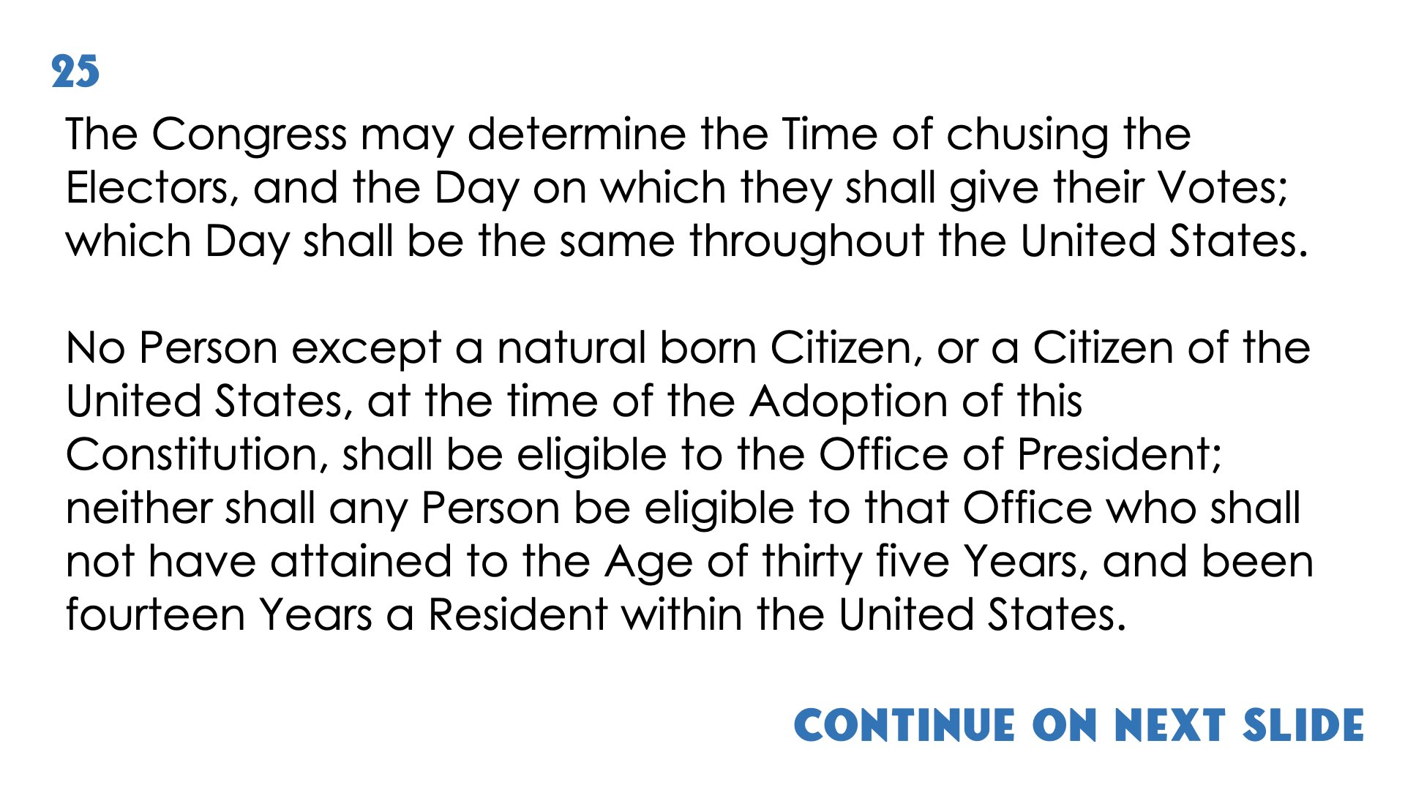
Continue on next slide

Slide 47
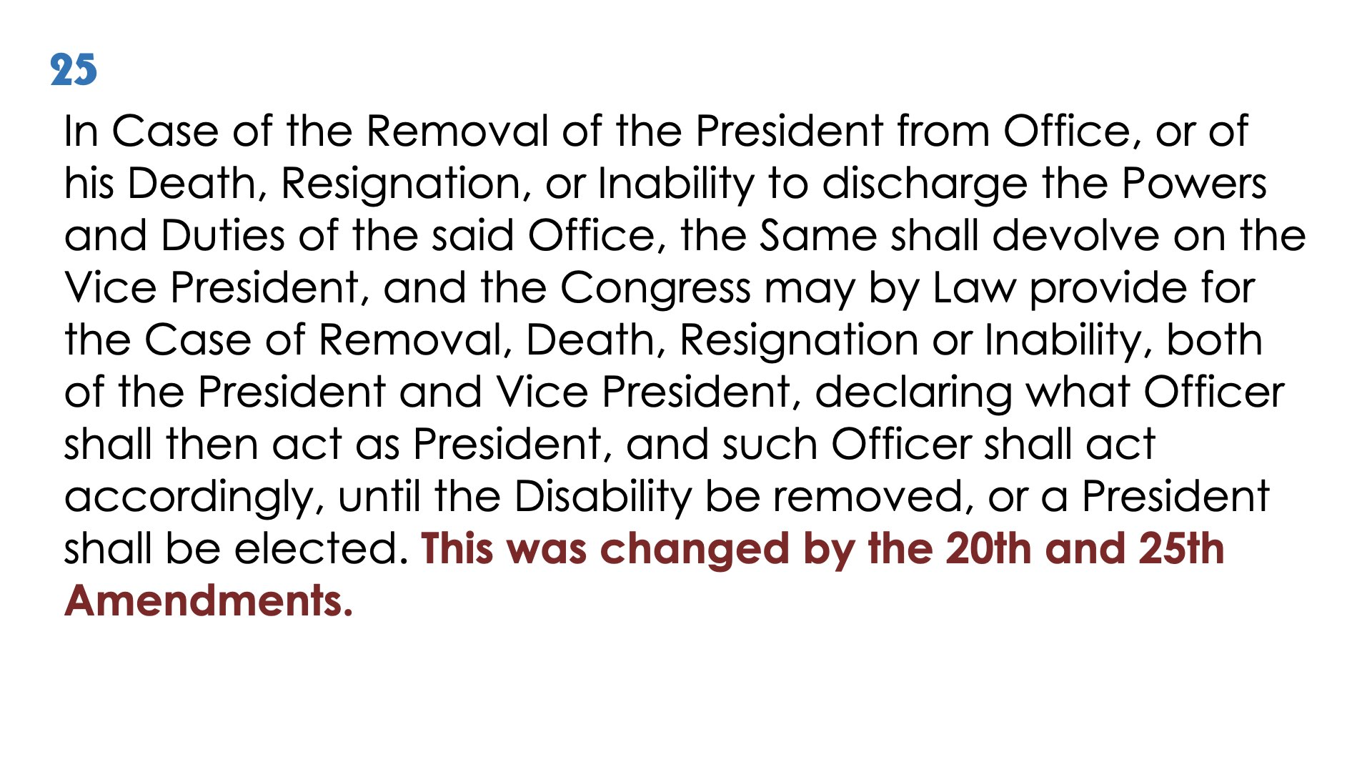

Slide 48
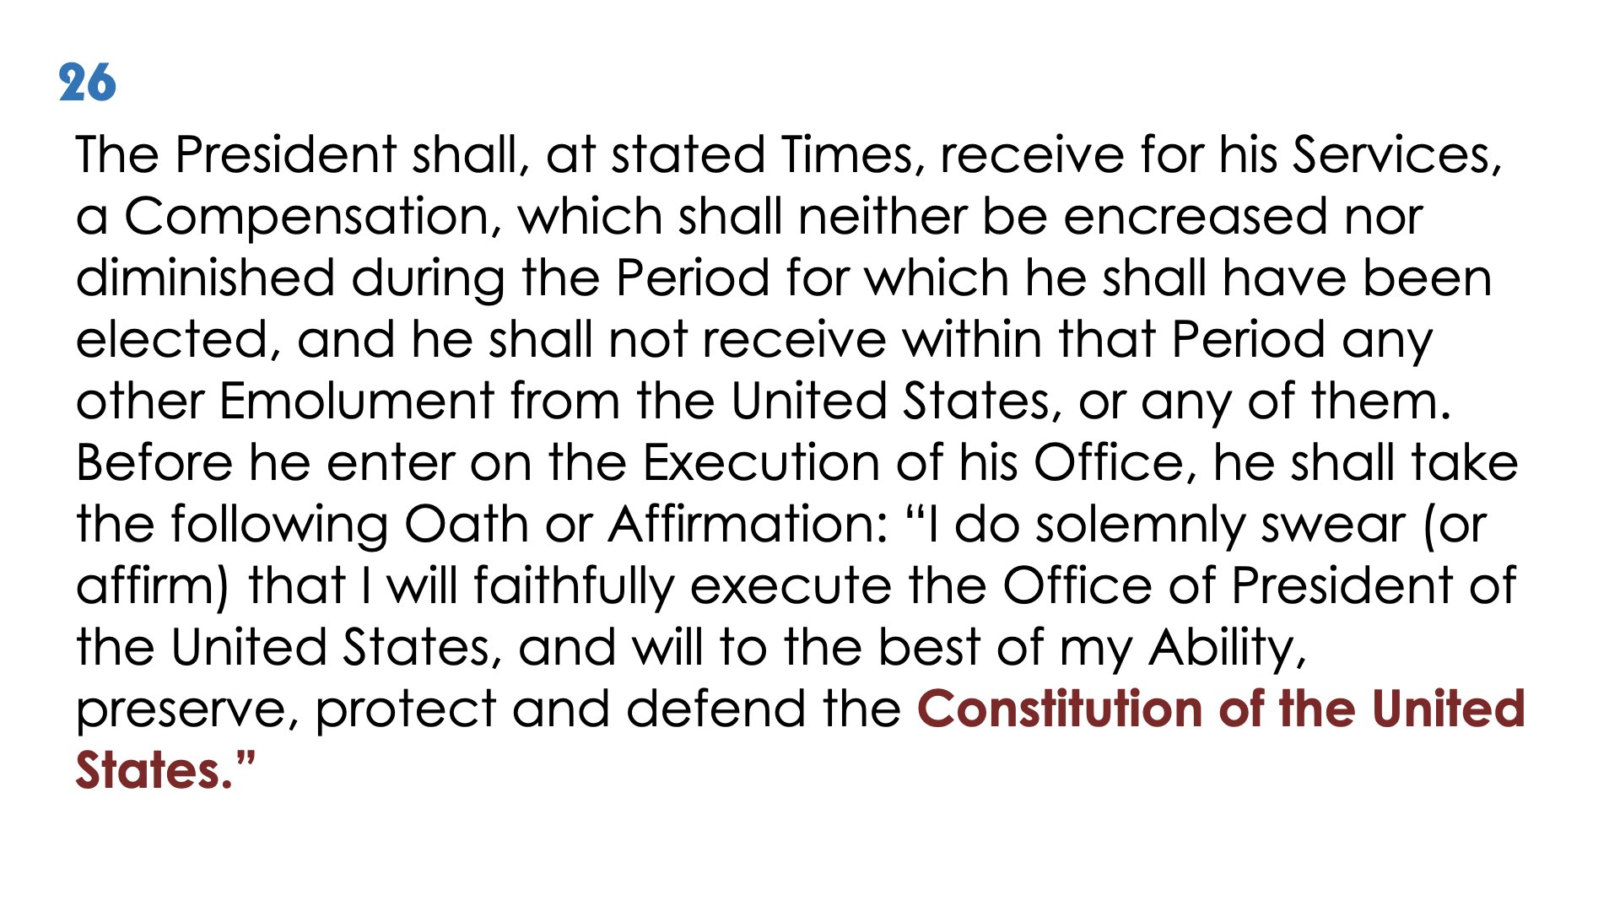

Slide 49
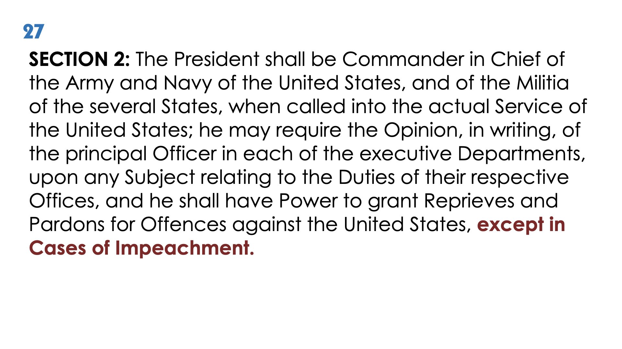

Slide 50
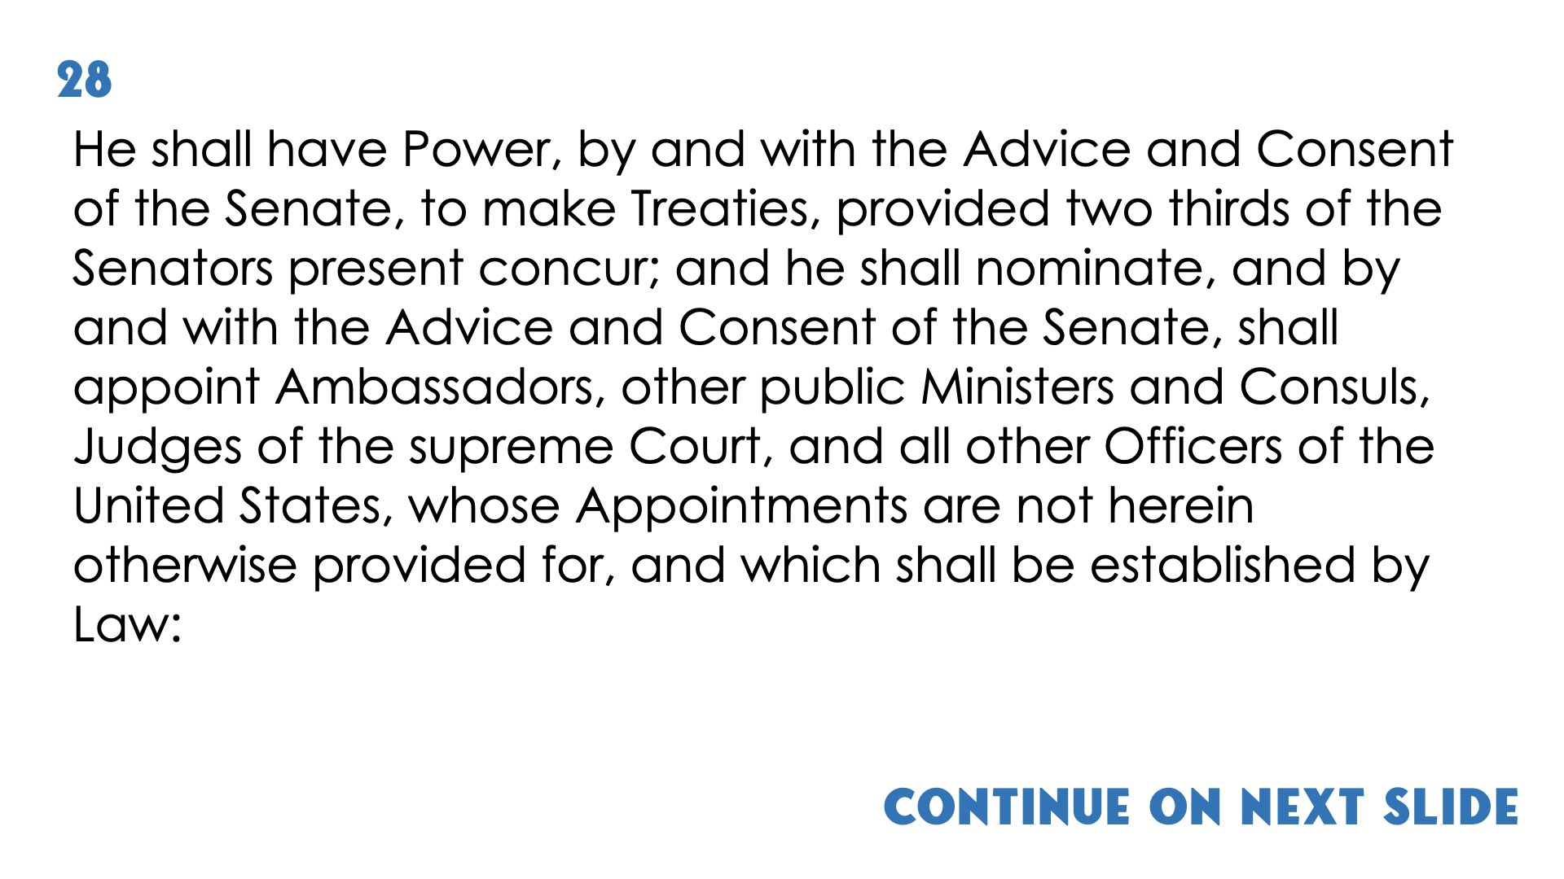
Continue on next slide

Slide 51
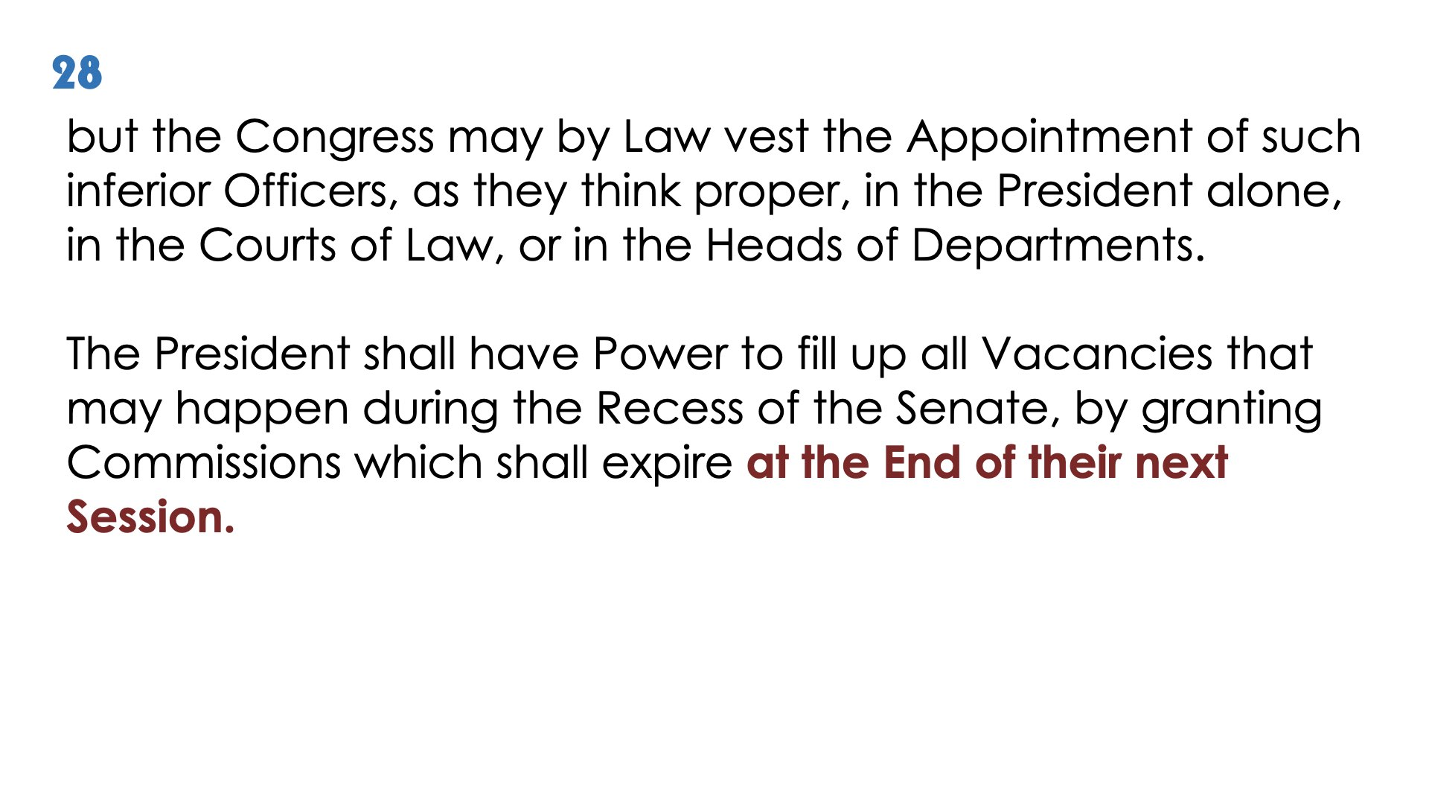

Slide 52
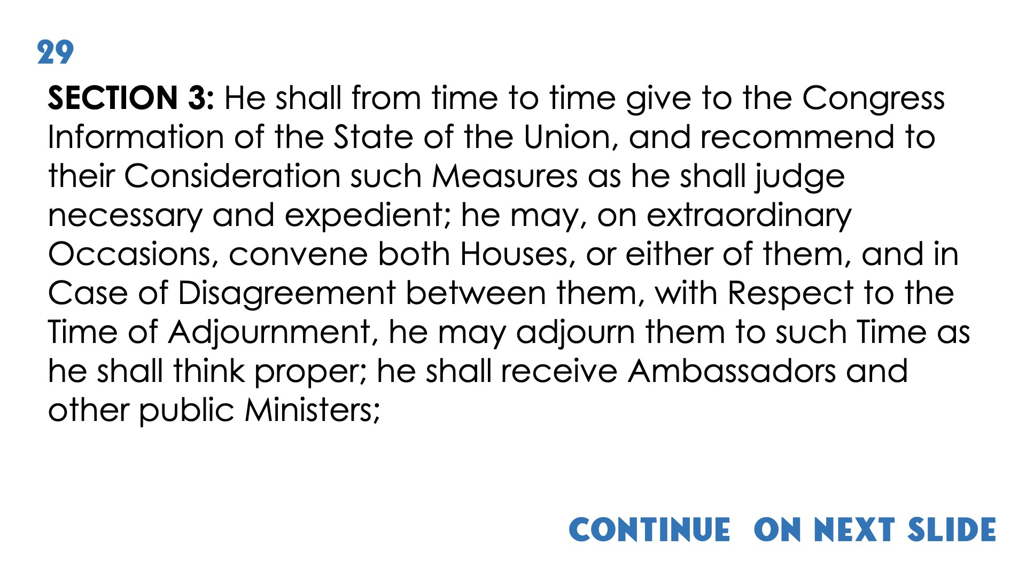
Continue on next slide

Slide 53
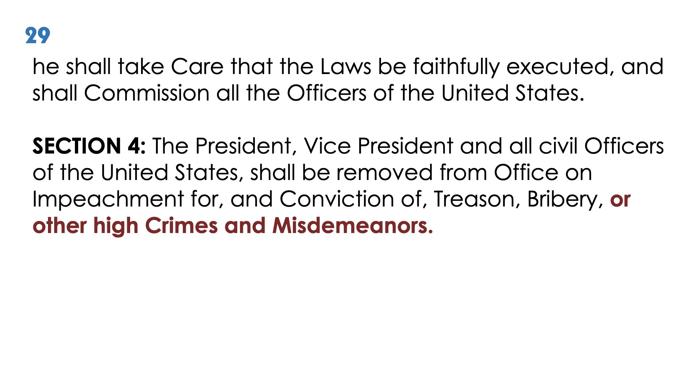

Slide 54
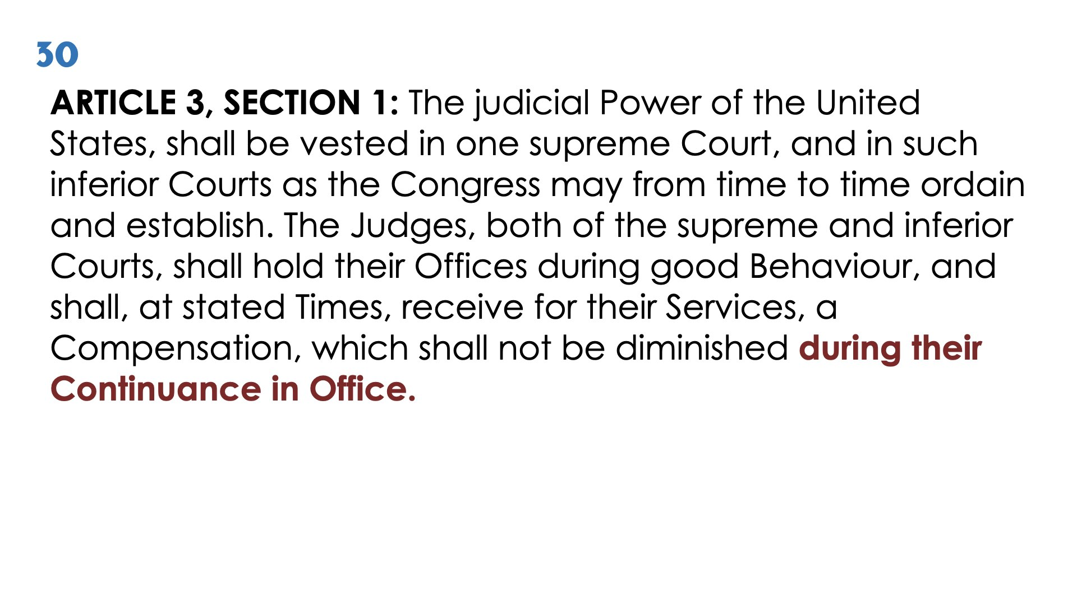

Slide 55
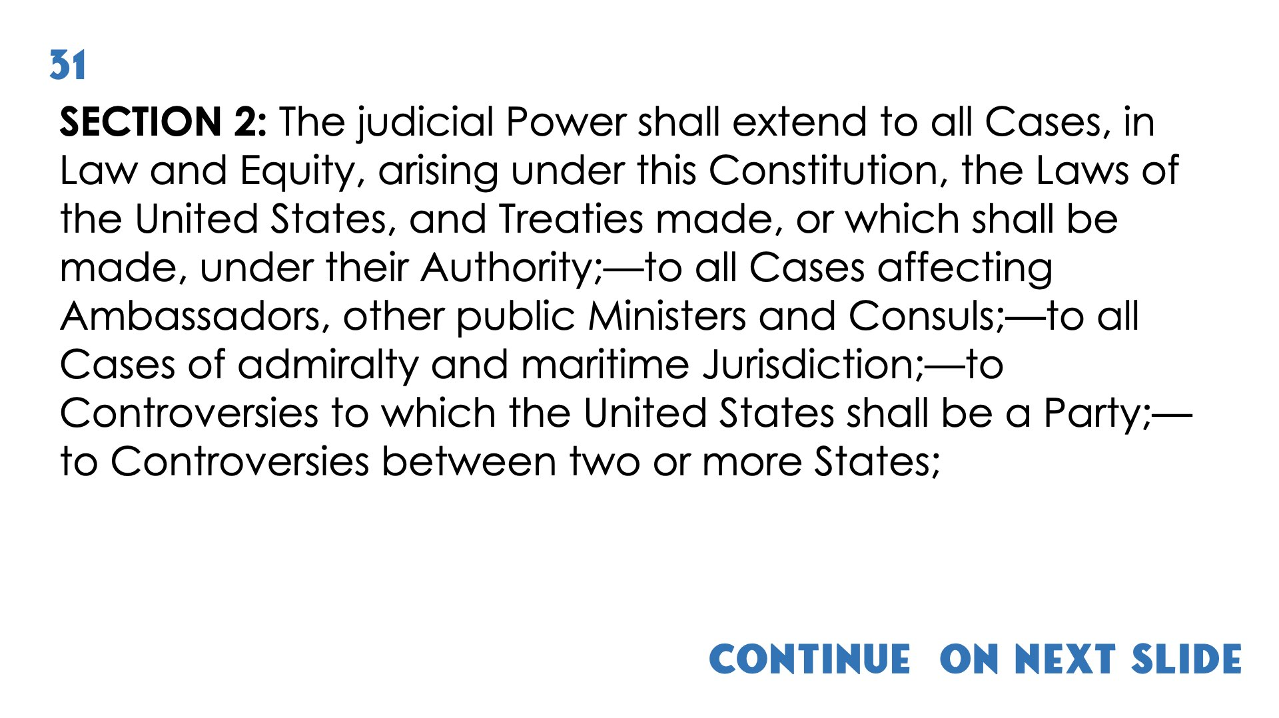
Continue on next slide

Slide 56
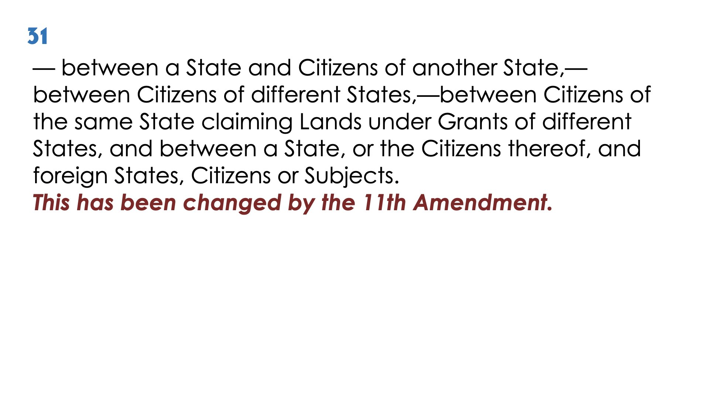

Slide 57
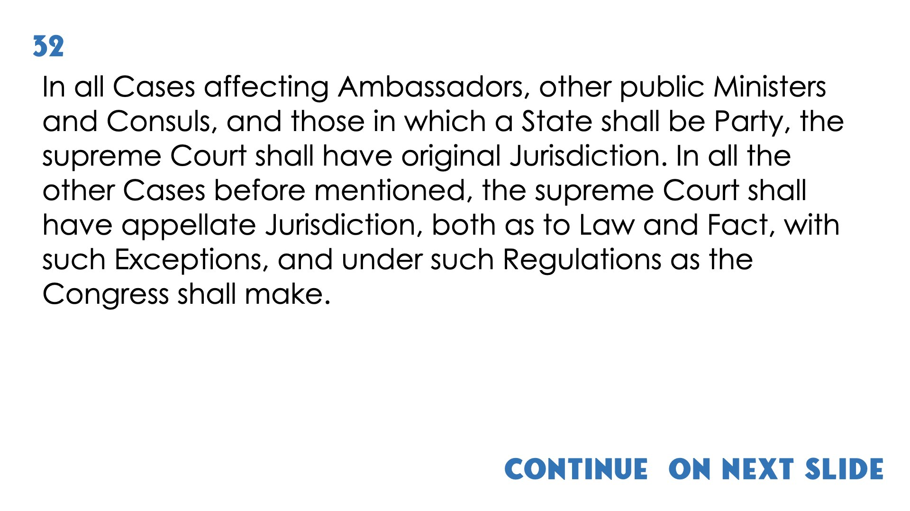
Continue on next slide

Slide 58


Slide 59


Slide 60


Slide 61


Slide 62


Slide 63


Slide 64

Continue on next slide

Slide 65


Slide 66

Continue on next slide

Slide 67


Slide 68


Slide 69
41
As we read the Bill of Rights, remember 3 delegates did not sign the Constitution because these enumerated rights were not included in the original document. However, as promised by those at the convention, the Bill of Rights were written and then adopted four years later on December 15th, 1791. These ten amendments, protect some of the most indispensable rights and liberties that define us as Americans. They are as follows:

Slide 70


Slide 71


Slide 72


Slide 73


Slide 74


Slide 75


Slide 76


Slide 77


Slide 78


Slide 79
51 A/B
A) Amendment 10: The powers not delegated to the United States by the Constitution, nor prohibited by it to the states, are reserved to the states respectively, or to the people.
B) Beyond the first ten amendments, known as the Bill of Rights, there are 17 additional amendments ratified between 1795 and 1992. Four selections from these amendments directly expanded the civil rights of all United States citizens. They are as follows:
Continue on next slide
(1)

Slide 80
51 A/B
A) Amendment 13: It was ratified in 1865 and contains two sections. The first section states, “Neither slavery nor involuntary servitude, except as a punishment for crime whereof the party shall have been duly convicted, shall exist within the United States, or any place subject to their jurisdiction.”
B) Amendment 14: It was ratified in 1868 and it has five sections. The first section reads, “All persons born or naturalized in the United States and subject to the jurisdiction thereof, are citizens of the United States and of the State wherein they reside.”
Continue on next slide
(2)

Slide 81
51 A/B
A) Amendment 15: It was ratified in 1870 and contains 2 sections. The first section states, “the right of citizens of the United States to vote shall not be denied or abridged by the United States or any State on account of race, color or previous condition of servitude…
B) Amendment 19: It was ratified in1920 and proclaims, “The right of citizens of the United States to vote shall not be denied or abridged by the United States or by any State on account of sex.
These amendments define the rightful participation of all citizens to be engaged in our Democratic Republic.
(3)

Slide 82
52
After spending the last 45 minutes together reading the Constitution and Bill of Rights, we are all more familiar with the supreme law of our land and are better able to have a meaningful conversation about the ideals of our country. Reading the Constitution will help us to protect and preserve our liberty! George Washington said, "The power under the Constitution will always be in the People." We are those people!" Thank you for joining us at Cedar City City Hall to
read the United States Constitution and Bill of Rights.

